Slide 1
Open publishing - current offerings for PUEB, useful search tools mgr Dorota Wojewoda Main Library as of 3.12.2023

Slide 2
Open publishing programs for PUEB faculty and doctoral students
Virtual Library of Science – a program of the Ministry of Education and Science for Polish academic and scientific institutions
- international databases - Databases - 100% financing or 50% subsidy for purchasing database subscriptions (national licenses, consortium licenses).
https://wbn.icm.edu.pl/
- Open publishing - covering all publishing costs for journal articles in selected foreign journals using the Open Access (OA) model.
https://wbn.icm.edu.pl/publikowanie-otwarte/
Purchase of licenses for databases and open publishing programs renewed annually, depending on the financial capacity of the Ministry of Education and Science, practically changing every year
Open access publishing programs in journals - 2024:
for all universities and scientific institutions in Poland: selected journals from Elsevier and Springer publishers, as well as the journal Science Advances
- for PUEB: selected journals of Cambridge and Emerald publishing companies

Slide 3
Elsevier open publishing program
APC fee exemption for publishing articles in selected Elsevier hybrid journals (1114 titles)
a list of titles: https://vls.icm.edu.pl/zasady/2023/Elsevier/czasopisma_elsevier2023_oa.xlsx
an additional list of titles for PUEB (since the 3rd quarter of 2023):
https://vls.icm.edu.pl/zasady/2023/Elsevier/czasopisma_elsevier2023_oa_ue_poznan_extra.xlsx
the national limit of titles for 2024: 1013 articles
the program is available for articles submitted to journals in 2024. You can only use it after your article has been accepted for publication, provided that the program pool is not full.
The program does not include additional fees that some Elsevier journals may require, like page charges and manuscript acceptance fees („Submission Fee”). These extra costs are handled directly between the journal and the author through a separate invoice.

Slide 4
Elsevier open publishing program
the corresponding author whose article has been reviewed and accepted for publication receives a link from Elsevier to the Rights and Access form
the form is used to choose between publication in a subscription or open access model. It also enables Polish authors to use the program.
if the institution, journal, and article type are included in the Polish program, the form will automatically provide the author with the option to publish openly under the program.
if the article meets the criteria for the program and there are still funds left in the program when the form is completed, the form will present the choice to waive the APC fee.
once the available pool is exhausted, articles that were initially chosen for the open model are then published in the subscription model.

Slide 5
Elsevier open publishing program
After the author selects the option for open publication in the program, the article will be sent for verification. Subsequently, the author will receive another email containing information about the verification outcome. Note: the author may choose to traditionally publish the article free of charge ("subscription" option) and this will not result in any restriction of future access to the program
Elsevier sends information about an article submitted to the program to the local administrator at PUEB, who is currently an employee of the PUEB Main Library - Dorota Wojewoda. She verifies the author's affiliation with the institution using an account in the online system.
If the author chooses the open access publication option, they must also choose the license type CC-BY or CC-BY-NC-ND, or in some journals, CC-BY-NC later in the form.
Information about the program, presentations: https://wbn.icm.edu.pl/publikowanie-otwarte/#elsevier_oa

Slide 6
Springer open publishing program
publishing open access articles under CC-BY license in selected Springer hybrid journals (1917 titles)
list of journals: https://vls.icm.edu.pl/zasady/2023/Springer/Springer_Publishing_List2023_05082023.xlsx
articles limit in 2023: 1350 articles, in 2024: ? (we are waiting for the decision of the Ministry of Science and Higher Education)
After the article is accepted for publication, the corresponding author receives an email containing a link to complete the publication process.
If, when filling out the form, there are still articles available in the program for the current year and the system identifies the chosen institution as part of the program, the form will show the message "Open access at no cost to you."
Information about an article approved for publication will be sent to the local administrator at PUEB (Dorota Wojewoda) for affiliation verification
Information about the program: https://wbn.icm.edu.pl/publikowanie-otwarte/#springer_oa

Slide 7
Open publishing program in the journal Science Advances
The program is an add-on to the national license for accessing the journal Science.
the journal Science operates on a subscription model only, while a separate journal, Science Advances, is dedicated to open access publishing (200 points according to the MSE)
The limit of articles for 2023: 10 [as of 22.11.2023: 1 article has been used]
The offer is available to corresponding authors affiliated with Polish institutions. The publishing house itself identifies the articles covered by the program.
In 2021, two articles were published under the program, and in 2022, three articles were published.
details: https://wbn.icm.edu.pl/publikowanie-otwarte/#science_oa

Slide 8
Open publishing programs for PUEB for 2024
1. Cambridge University Press (CUP)
Offer for PUEB – a possibility to publish OA articles in selected journals (no limits)
Journals search engine: https://www.cambridge.org/core/services/open-access-policies/waivers-discounts
2. Emerald – program only for PUEB
- limit of articles: 2

Slide 9
An author’s right to control the distribution of their articles – useful engines
Journals published in Poland:
- Arianta free database https://arianta.pl/
- Information about: the publisher, MSHE points, IF index, licences, APC fees, etc.
2. Journal published abroad and in Poland
- SHERPA ROMEO free database https://www.sherpa.ac.uk/romeo/
information on what the author can do with the article: sent for review (submitted version), reviewed and accepted for publication (accepted version), published (published version), etc.
Sometimes, the journal information includes the author's terms of access to the article, depending on which institution funded its publication (Pathway a, Pathway b...,)
- Information on 765 journals published in Poland (as of 11.01.2024)

Slide 10
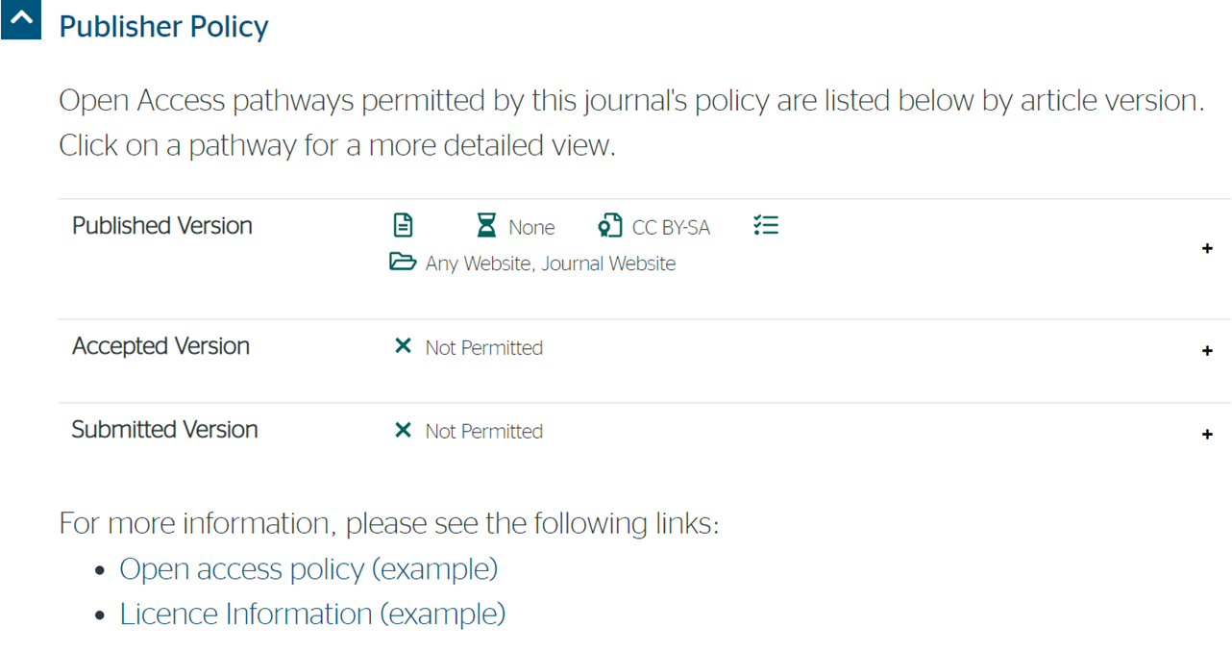
SHERPA ROMEO – information on the journal Econometrics/Ekonometria published in Wrocław

Slide 11
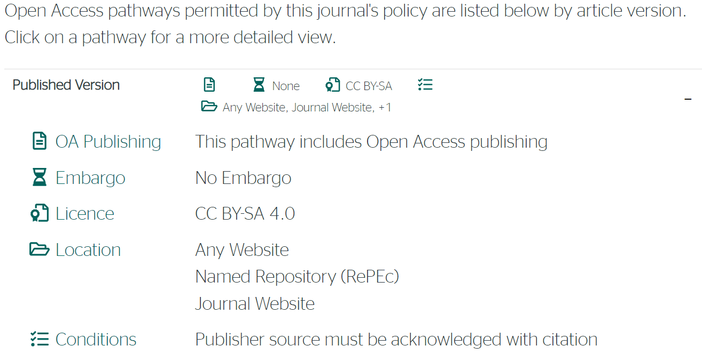
SHERPA ROMEO – information on the journal Econometrics/Ekonometria published in Wrocław

Slide 12
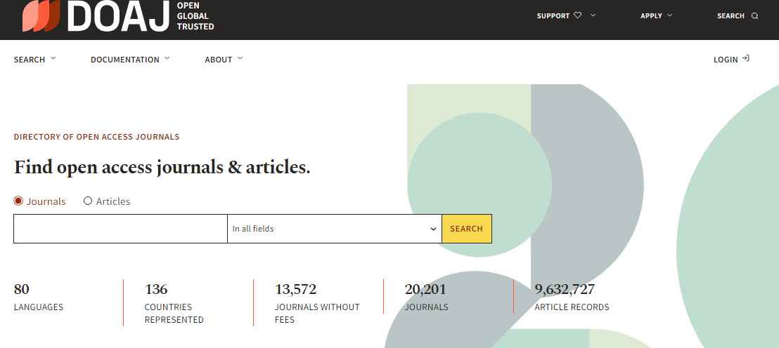
DOAJ – Directory Open Access Journals
https://doaj.org/
A directory of journals that publish articles using the Open Access model, providing details on journals with reliable publishing and review processes.

Slide 13
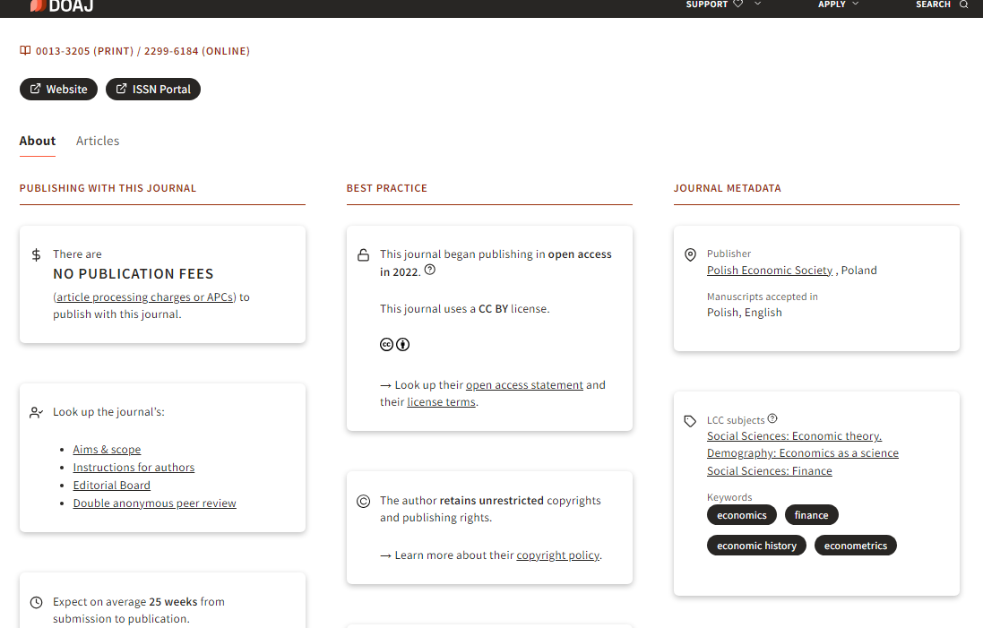
DOAJ – the journal „The Economist”/Ekonomista profile

Slide 14
Research data – online courses
Free online courses in Polish - Research Data Management- Research data Management for Researchers - basic course
https://navoica.pl/courses/course-v1:UniwersytetWarszawski+RDM_03+2023_01/about
Research data Management for Researchers – intermediate course
https://navoica.pl/courses/course-v1:UniwersytetWarszawski+RDM_04+2023_01/about

