Slide 1
Data Management Plan Research Office January 12, 2024

Slide 2
Grantors' current requirements regarding Open Research Data
An increasing number of science and research project funding bodies require the researcher to produce a data management plan in the project proposal as part of open science.
Grantors requiring a data management plan:
NCN National Science Centre - all competitions including MINIATURA
No required plan:
NCBR - applied, outcome-oriented, commercially viable projects
Competitions of the Foundation for Polish Science
European Commission: Horizon Europe applications
MEIN - projects aimed at promoting science, focusing on institutions, not on individual research
NAWA - urgency grants

Slide 3
National Science Centre
Data Management Plan - a separate section of the project proposal and clear guidelines on how to interpret the relevant items and how to complete them

Slide 4
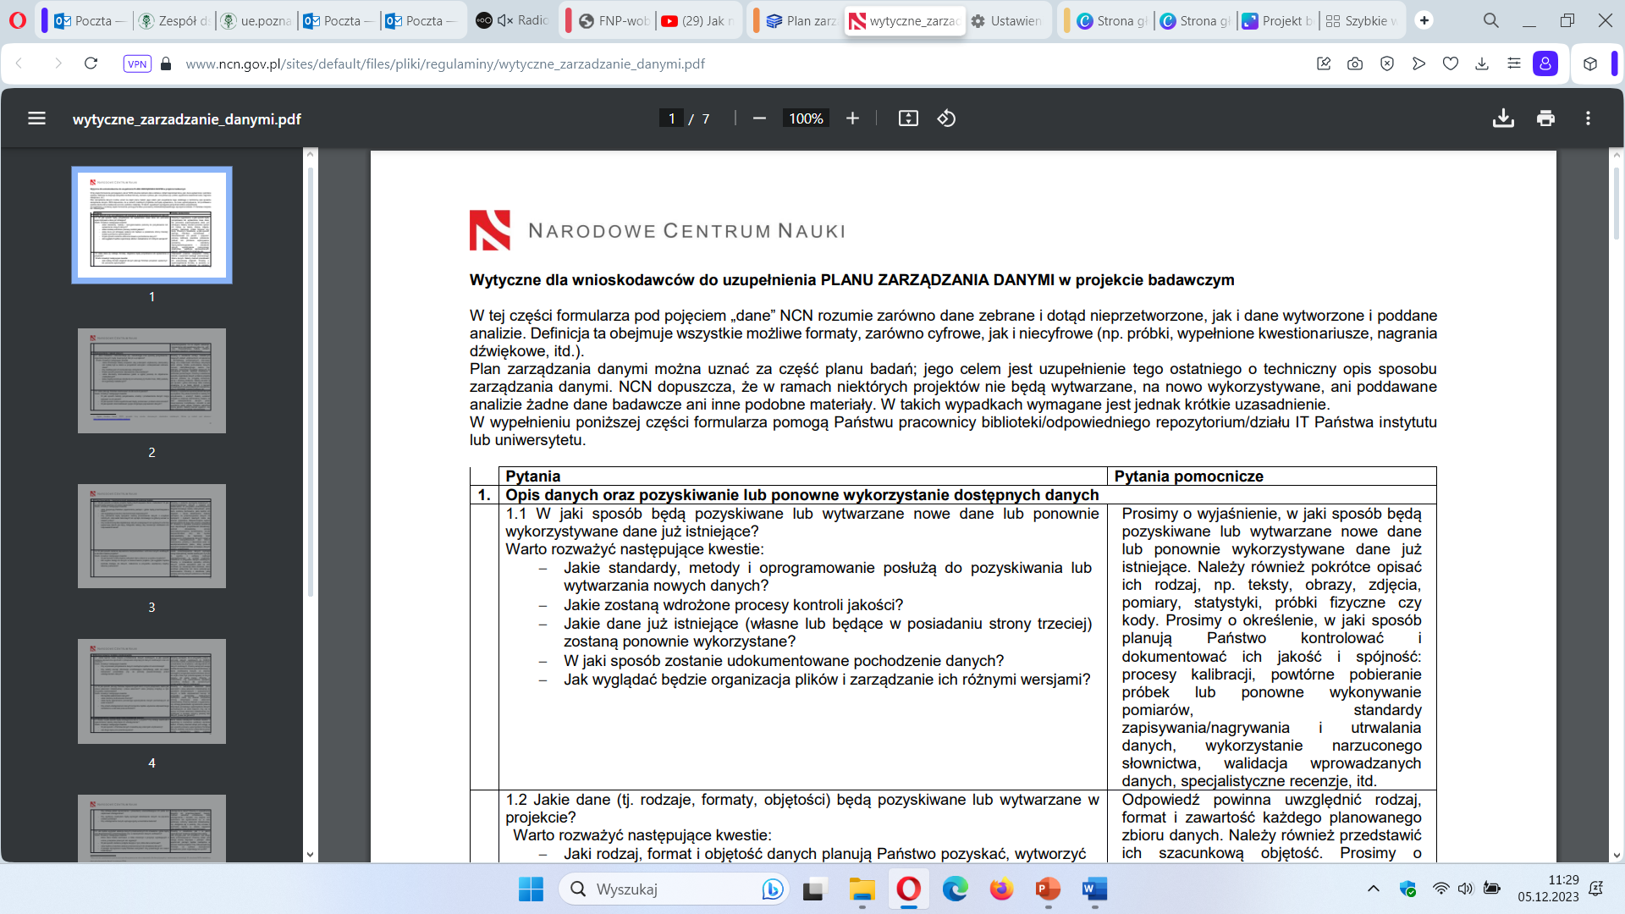
When drafting a project proposal and completing a DMP
https://www.ncn.gov.pl/sites/default/files/pliki/regulaminy/wytyczne_zarzadzanie_danymi.pdf

Slide 5
Data Management Plan – general guidelines
DMP specifies:
how research data will be produced, do I use existing data or produce new raw data?
what file formats will be used (preferably open source), how will they be catalogued/described - metadata?
how do I secure/store it, i.e. develop a backup plan to prevent data loss due to e.g. hardware failure? (please note: not in commercial clouds or outside the EU)
how do I comply with ethical and legal issues, personal data protection?
how do I share it, can I share it all? When? And in which repository? (Licences and DOI)
how is my institution and the project team supporting me in this (infrastructure, regulatory acts, safeguards), who is the data steward in the project

Slide 6
Data Management Plan - general guidelines
There is no single template, no copy-paste format.
Each DMP is different, just as research projects are different.
It is closely aligned with the research plan - it reflects the research being undertaken and what happens to the data as it is carried out, it is a technical description of how the data will be managed in the project.
An important tip:
Respond in a concise, factual and precise manner.
What you commit to will be revisited, i.e. the plan will be further expanded upon at the final report submission stage and evaluated at the end of the project.

Slide 7
When drafting a project proposal and completing a DMP

Slide 8
When drafting a project proposal and completing a DMP

Slide 9
When drafting a project proposal and completing a DMP

Slide 10
Data Management Plan - Research Office support
On the basis of the NCN guidelines, as well as training courses attended, a template has been prepared with suggested prompts as to what information, phrases, examples of protection, safeguards etc. can be incorporated in the project proposal.
The file will be available for download on the PUEB Research Office website, after logging in
https://ue.poznan.pl/pracownicy/know-how-badacza-uep/

Slide 11
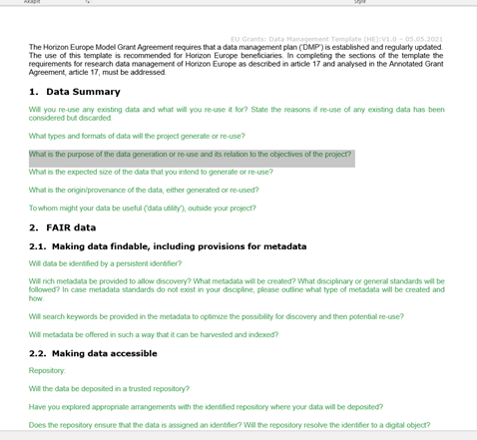
Data Management Plan – Horizon Europe
https://scienceeurope.org/our-priorities/research-data/research-data-management/

