Slide 1


NCN PRELUDIUM 25
Information for applicants

Slide 2

Basic information
Call NCN Preludium 25 is dedicated for people starting out their research career, ie. they do not hold a PhD title yet
Apply via OSF - https://osf.opi.org.pl
The proposal will be evaluated in three criteria – quality of the proposal, and the qualifications and achievements of the PI (you) and your mentor in the field
Project Support Office is responsible for assisting you in your application process at PUEB (contact person Mateusz.Wielebinski@ue.poznan.pl )
PRELUDIUM requires a designated mentor – it does not have to be your PhD supervisor

Slide 3


Timeline
Read the documentation and start completing the application in OSF
Submit Project Information Sheet containing all the requested information, especially budget in Xprimer, as well as mentor’s declaration
These need TO BE ACCEPTED by 29th May (your Mentor, Bursar, Project Office and Vice-rector all need to accept it, the process usually takes 2-5 days, prepare in advance)
Finish and lock in the application in OSF to be able to download the declaration document
These need to be sent to Project Office for Rector’s signature by 11th June
Project Office will send them back to you for you to upload them to OSF, which will enable „submit” buton
Final submission deadline in the OSF is 16th June, 14:00

Slide 4
Read the documentation
The first step is to carefully read the call’s documentation: https://ncn.gov.pl/en/ogloszenia/konkursy/preludium25
NCN website contains all relevant FAQs, attachments, guidelines on each application section, budgeting etc. – pdf attachments are especially helpful!
Moreover, National Science Centre has a comprehensive offer of online training sessions for applicants, regarding the purpose of specific calls, application procedures, or evaluation procedure. We recommend attending those sessions. You can sign up for them at:
https://www.ncn.gov.pl/en/finansowanie-nauki/informacje-dla-wnioskodawcow/warsztaty-dla-wnioskodawcow

Slide 5
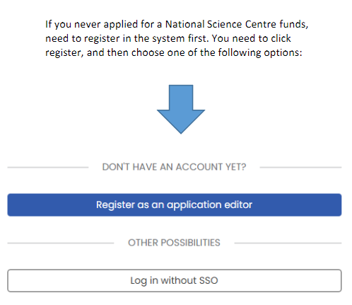
Creating an application
Signing up for OSF (Zintegrowany SystemUsług dla Nauki – Obsługa Strumieni Finansowania / Funding Stream Support System - Integrated System of Services for Science)
Click the https://osf.opi.org.pl/en then „go to system”, and then Register as an editor (if you do not have an account already or log in
After logging in, in the „New application” tab choose PRELUDIUM
When the system asks you for your project’s duration (12, 24, 36 months) in the beginning of the process, be careful – the only way to change it is to create a new application from scratch!

Slide 6
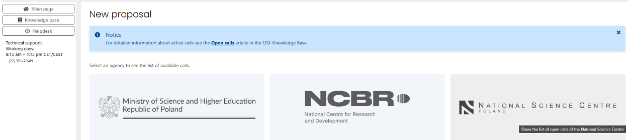
Creating an application
Click NOWY WNIOSEK and choose the funding body you are applying for. This guide is specifically tailored for National Science Centre / Narodowe Centrum Nauki. Once clicked, you will see a list of open calls and their deadlines.
To create a new application, click the blue link. You will be first asked to declare the project duration (in calls that allow flexibility in that regard). The layout can differ slightly depending on the particular call.

Slide 7
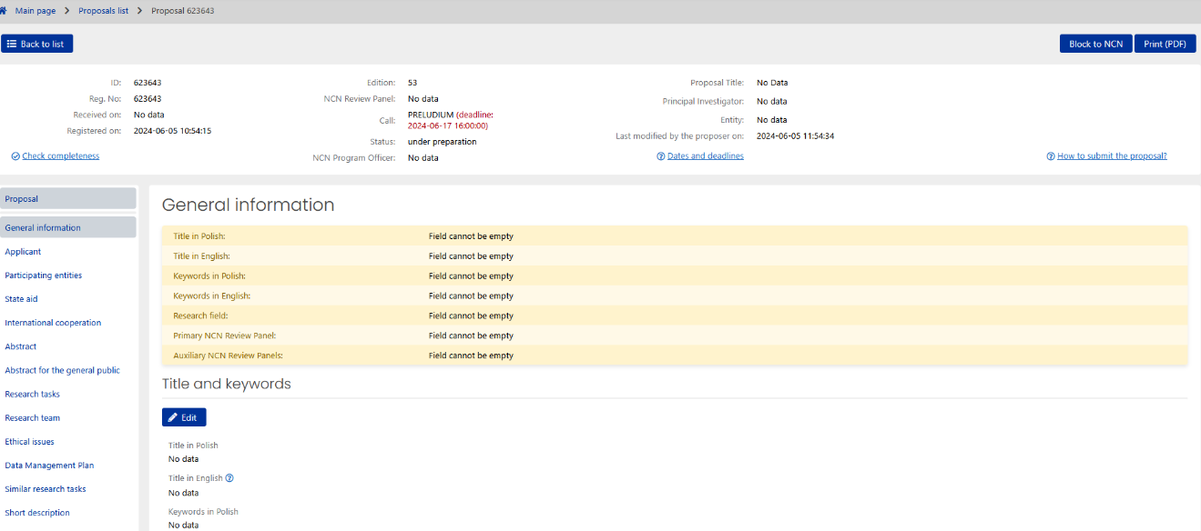
What you should see

Slide 8
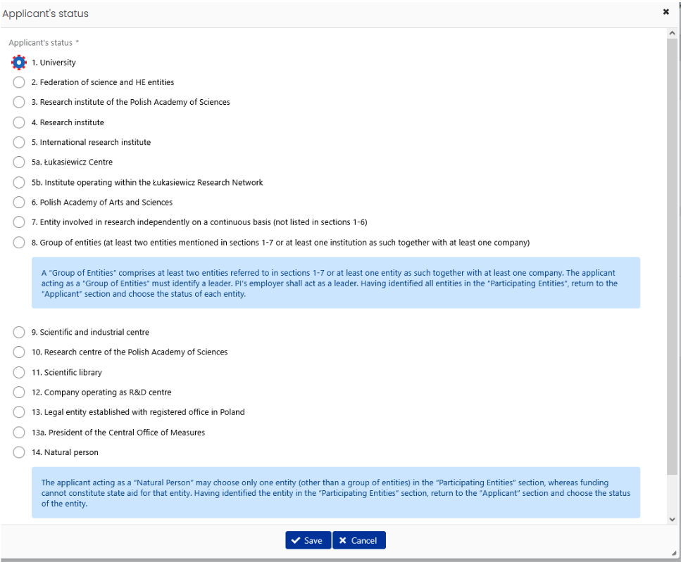

If you are
applying as a
PhD student at
PUEB – the
wnioskodawca is
1. University

Slide 9
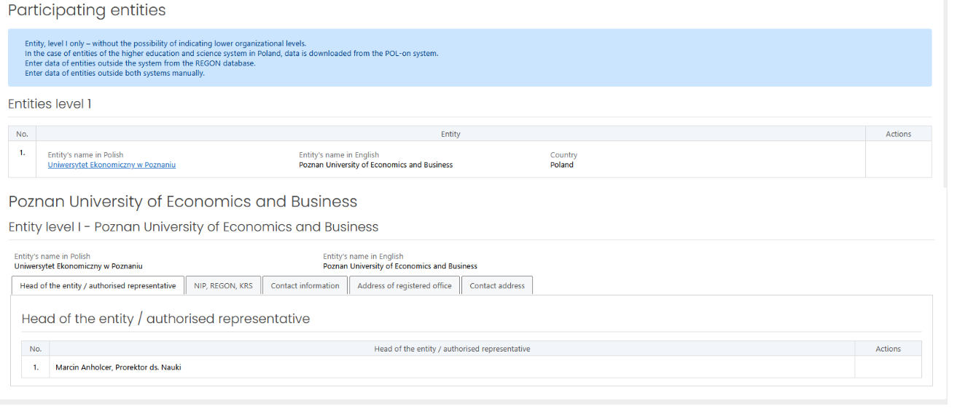
Dr. hab.Marcin Anholcer, Prof. PUEB, as Vice-Rector for Science, is the person authorised to represent UEP in matters related to research projects. Select PUEB and his name as the authorised representative

Slide 10
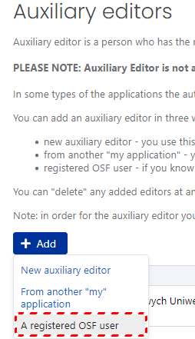
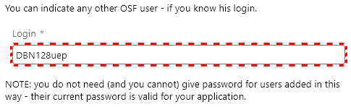
Add DBN128uep (case sensitive!) as an Auxiliary Editor. This is Project Office’s login – we will be able to monitor your progress, as well as to help you directly with your application.

Slide 11
Fill in your application
Streszczenie / Abstract
  Entered as a plain text (ca. 4500 character limit, including spaces)
  You need to include the research problem, aims, methods and expected results
  Be plain and straightforward so that a person not familiar with your research area (but familiar with scientific method) could understand and relate to your idea
Streszczenie popularnonaukowe / Abstract for the General Public
  Upload the summary as two separate PDFs (one for Polish and English language each), 1 A4 page each
  Avoid jargon and complicated sentences
Plan badań / Research Tasks
  Outline the main tasks (e.g. 2-10 specific actions)
  Skip purely technical tasks (e.g. „purchase of equipment”) and instead focus on those centred around the research process („research data analysis”, „an investigation of X using Y method”)
  If you are expecting publishing an article, a presentation at a conference or similar actions, you can include those under a wider term (e.g. „Research results dissemination”)
Zespół badawczy / Research Team
  Add members of the team (including you – the PI!)
  Clearly describe the experience each team member brings (achievements in the field) and outline what tasks each of you will be taking on (avoid everyone does everything situation – preferably, each member has participates in a different set of tasks)
  If you are a PhD student, your supervisor’s achievements are also a part of the evaluation criteria, though in PRELUDIUM projects, the PhD student is formally the PI

Slide 12
Fill in your application
Opis skrócony (max. 5 stron) / Short description (5 page limit)
  Is the key part in the first-stage substantive review
  It should contain
    Aim of the project (research problem, hypotheses)
    Significance of the project (current state of knowledge, research gap, innovativeness of the project, impact on the field)
    Research plan (plan, initial results, risk analysis)
    Research methods (including research equipment)
    Bibliography (appropriately prepared with complete information)
Opis szczegółowy (max. 15 stron) / Detailed Description (15 page limit)
  Reviewed in the second stage, by an expert close to your field
  More in-depth information and nuance
  It should contain all information mentioned in the short description, but including an explanation of suitability of each aspect of your plan, method description, and entry data
Kwestie etyczne (Ethical Issues)
  Fill in the survey in OSF system
  If you answer YES to any question, you need to explain what steps you are going to take to maintain a good standard of ethics
Plan Zarządzania Danymi (DMP) / Data Management Plan
  List the types of data created in the project and explain how you are going to store them securely in short and long term, as well as how you are going to make them FAIR (Findable, Accessible, Interoperable, Reusable) for anyone wishing to use them afterwards
  If no new data is going to be created in this project, state this explicitly

Slide 13
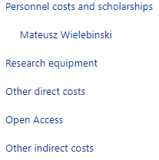
Plan your budget
Be careful when filling in these categories
PRELUDIUM has a budget available for your pay, with a set monthly amount
Please follow the NCN guidelines on their website to make sure you are putting in the correct values / assign correct categories to your expenses
you can estimate the travel costs based on the governmental tables for work travel via government guidelines Dz.U. 2023 poz. 2190
Indirect costs should be set to 20% and OA indirect costs to 2% (maximum)

Slide 14
An example of travel cost calculation
Each year we plan to present our results on the xxx conference and/or other scientific meetings. XXX persons from our team will participate in conferences, meetings or workshops.
Estimated costs per person:
POLAND
  Fee: 1200 PLN + subsistence: 45 PLN x 5 days = 225 PLN + Accommodation: 300 PLN x 4 nights = 1 200 PLN + Travel: 250 PLN »
  Total cost: 2 875 PLN
EUROPE
  Fee: € 600 + subsistence € 57 x 5 days = € 285 + Accommodation: € 200 x 4 nights = € 800 + Travel: average € 500 » Total: € 2185
  EUR x 4.72 = 10 313,2 PLN (rounded to 10 310 PLN)
USA/ASIA
  Fee: $ 800 + subsistence: $ 59 x 7 days = $ 413 + Accommodation: $ 200 x 6 nights = $ 1 200 + Travel: $ 1 000 » Total: $ 3 413 x
  4.75 = 16 211,75 PLN (rounded to 16 210 PLN)
Altogether xxx conferences in Poland [xxx PLN], Europe [xxx PLN] and xxx conferences outside Europe [xxxx PLN] are planned. Total estimated costs xxx PLN. The costs have been estimated according to the NBP average exchange rate of xx, xxxx (1 EUR = 4.72 PLN; 1 USD = 4,75 PLN), previous experience, available information on travel costs, and on the basis of the Regulation of The Minister of Labour and Social Policy on business travels.

Slide 15
Finishing your application
Validate the completeness of the application in OSF
  Use the Validate option to see if you missed any section
  Check, whether you uploaded all attachments (popular science description, publication list, short summary, detailed description, etc.)
Get an approval letter signed (via PUEB internal procedure)
  Once the application is complete send the generated declaration to the Project Office via email, to be given for Vice-Rector’s signature
  After locking-in the application to generate the declaration, YOU CANNOT EDIT your application anymore. You can reverse it, but the declaration created by the system will become invalid. If you unlock, edit, and then re-lock the application, you need to download and request a signature for the new declaration. Otherwise, the application will be rejected!
Upon formal approval of the University, the application can be submitted to National Science Centre in the OSF system

Slide 16
Internal Procedure – Project Information Sheet
All research project applications need to be approved by the vice-rector for research before submission
For PRELUDIUM, you need your mentor to also sign a declaration stating that they will assist you with administrative burden, as not every employee procedure is available to non-employees, ie. students and PhD students
Download the templates from https://ue.poznan.pl/skocz-do/know-how-badacza-uep-karta-projektu and fill in the documents
You need to send it for acceptence via Xprimer service, using Pismo Wewnętrzne option

Slide 17
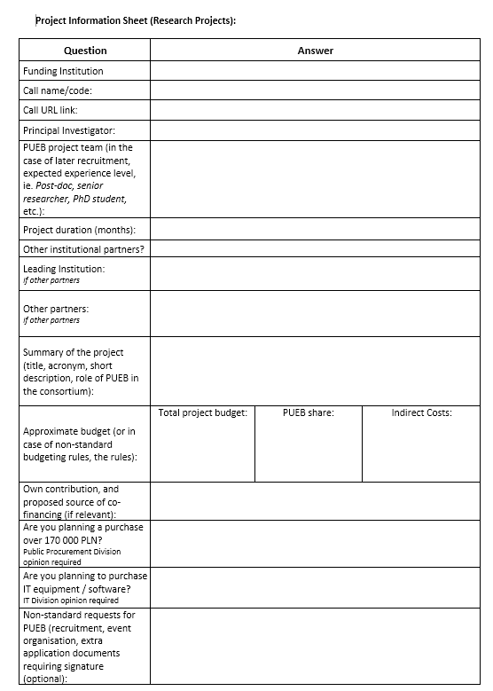
Project Information Sheet
A short questionnaire regarding the project
The most crucial parts are the ones regarding budgeting and purchases (bottom of the page)
On the second page, there are declarations regarding the renumeration rules
PRELUDIUM, like most NCN projects, have their own renumeration practices, so the tables in Regulamin Wynagradzania do not concern you in this project

Slide 18
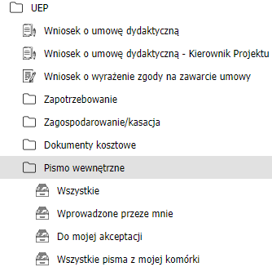
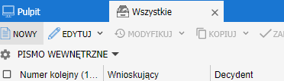
XPrimer
The Project Information Sheet has to be submitted via XPrimer
The system is now available to PhD students as well
Applicants who are neither PhD students nor employees of PUEB (no NIU number) have to request either their mentor or Project Office to submit the filled-in documents in their name
Use „Pismo wewnętrzne” option to submit the documents

Slide 19
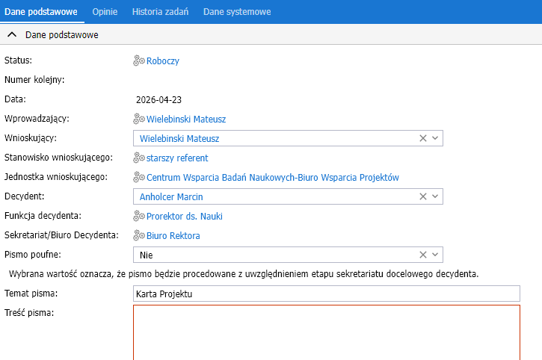
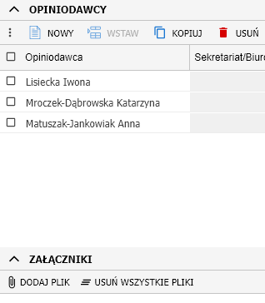
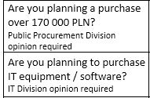
Pismo Wewnętrzne
Create a new Pismo, and point to „Anholcer Marcin” as decydent
In Opiniodawcy field, you need to put:
  Your mentor (optionally, you can use this process to approve the supervisor’s declaration instead of a traditional signature
  Lisiecka Iwona and Mroczek-Dąbrowska Katarzyna (head of Project Office, and director of Research Support Centre)
  Matuszak-Jankowiak Anna (Bursar)
  Grzeszczak Przemysław (optionally, if IT opinion required)
  Adamski Roman (optionally, if Public Procurement opinion required)
Add the Project Information Sheet and Mentor’s Declaration in the Załączniki (attachments) field

Slide 20
Consultations and advice
PUEB offers assistance in completing the applications
For formal matters (attachments, cost categories, internal policy guidelines), refer to the Project Office (cwbn@ue.poznan.pl , MS Teams – Mateusz Wielebinski)
For DMPs, you can use the address rdm@ue.poznan.pl
Thanks to RIGE project funding, PUEB can now provide an additional, voluntary review of the substantive part of the application. PUEB has a pool of experienced PIs, who can review your application confidentially, point out the strengths and weaknesses of your project, suggest concrete changes to your application, or recommend adding more information that would improve the overall strength of your proposal
The information regarding this review is located at the following address: https://ue.poznan.pl/en/university/rige-project/

Slide 21
A Few Tips
Keep the deadlines!
Create your budget early – you can submit the Project Information Sheet while working on your detailed description
Be consistent – if you are editing a near-complete application, double-check if a change in one section is reflected in others (e.g. if any change in description requires a change in the budget as well)
Keep your mentor and Project Office in the loop – we can assist you if are unsure of anything
Balance pragmatism and ambition – while an excellent, innovative research concept catches the eyes of the reviewers, reasonable budgeting and sensible research task plan is needed to convince them it is actually plausible

Slide 22

Thank you, and good luck with your applications!

