Slide 1
Poznan University of Economics, October 2015 By Gary Evans, PhD
Grounded Theory Presentation

Slide 2
Research Methodology /Qualitative Research
Not everything that can be counted counts and not everything that counts can be counted.
( Albert Einstein )
Grounded Theory
Barney Glaser
Anselm Strauss
The aim, as Glaser in particular states it, is to discover the theory implicit in the data.

Slide 3
Objectives
Provide a Background on Grounded Theory
Explain what it is and is not
Review the 4 main types of Grounded Theory
Explain the Differences
Share the Value and Importance of Qualitative Research Methodologies

Slide 4
Substantive Theory
Substantive theory is a strategic link in the formulation and generation of grounded formal theory. We believe that although formal theory can be generated directly from data, it is more desirable, and usually necessary, to start the formal theory from a substantive one. The latter not only provides a stimulus to a “good idea” but it also gives an initial direction in developing relevant categories and properties and in choosing possible modes of integration. Indeed it is difficult to find a grounded formal theory that was not in some way stimulated by substantive theory.
(Glaser & Strauss, 1967: 79)

Slide 5
Where do you use Grounded Theory?
As Martin and Turner
(1986) observed, grounded theory is best used
when no explicit hypotheses exist to be tested, or
when such hypotheses do exist but are too abstract
to be tested in a logical, deductive manner. This is
where grounded theory is most appropriate—
where researchers have an interesting phenomenon
without explanation and from which they seek to
“discover theory from data” (Glaser & Strauss,
1967: 1).

Slide 6
Key concepts of Grounded Theory
An approach to describe relationships where little is known or to provide a fresh take on existing knowledge
A method to systematically build integrated sets of concepts from systematically obtained empirical data
A process of composing knowledge through intimate contact with subjects and events under study
A theory that is shaped by data as well as by the researcher
Key concepts: knowledge discovery, knowledge evolution, emergent relationships

Slide 7
What Grounded Theory is Not (Roy Suddaby 2006)
7 Myths
Grounded Theory Is Not an Excuse to Ignore the
Literature
Grounded Theory Is Not Presentation
of Raw Data
Grounded Theory Is Not Theory Testing, Content
Analysis, or Word Counts
Grounded Theory Is Not Simply Routine
Application of Formulaic Technique to Data
Grounded Theory Is Not Perfect
Grounded Theory Is Not Easy
Grounded Theory Is Not an Excuse for the
Absence of a Methodology

Slide 8
What are the TYPES of Grounded Theory
Feminist Grounded Theory - Judy Wuest
Grounded Theory CGT – Barney Glaser
Straussian Grounded Theory - Anselm Strauss
Constructivist Grounded Theory - Kathy Charmaz

Slide 9
Feminist Grounded Theory – Judy Wuest
Initially for nurses in recognition of the andocentric
bias and to ensure that women's voices were heard in the research community
Wuest selects methodological elements from all three grounded
theories to put forward the importance of merging with feminist theory
“[g]rounded theory is consistent with the postmodern
feminist epistemology in the recognition of multiple explanations of reality” (Wuest, 1995,
p. 127).

Slide 10
Classical Grounded Theory CGT - Barney Glaser
Stayed true to the original format of grounded theory
All is data
Can be used in wide range of qualitative studies
Has two levels of coding, Substantive (Open) and Theoretical
Is only used to develop theory not test the theory
Does not start with a hypothesis
Induction is key process with deduction occurring on emerging questions
All other forms of Grounded Theory are not grounded theory but a version of QDA.
Literature review not done until after substantive theory is starting to develop

Slide 11
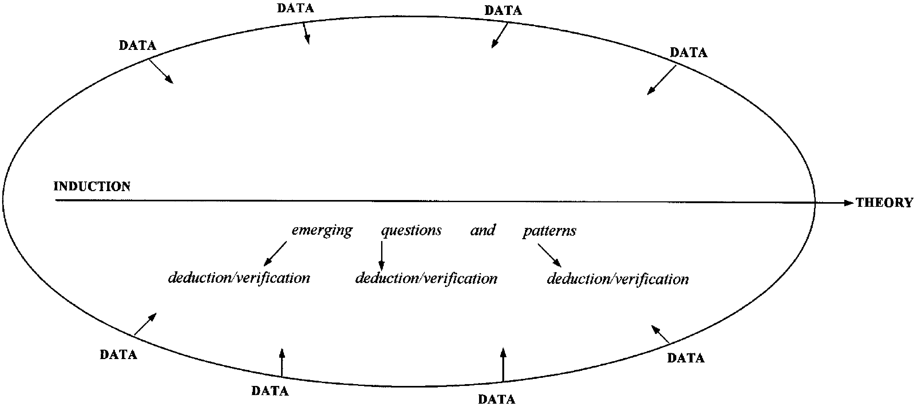
Glaser (1978, 1992) place of induction, deduction and veriﬁcation in grounded theory analysis. (Heath and Cowley, 2004, p.144)

Slide 12
Source: Holton (2007), adapted by Loy (2011, p.54), modifications by the author

Slide 13
Straussian Grounded Theory – Anseim Strauss
Straussian approach puts more emphasis on deduction and verification, often leading the researcher away from the data and into following prior research and knowledge
More procedures on how to code and structure the data
Coding process includes Open, Axial and Theortical (Axial is unique to Straussian)
Different philosophical use of induction, deduction, and verification
Literature review done at beginning of study

Slide 14
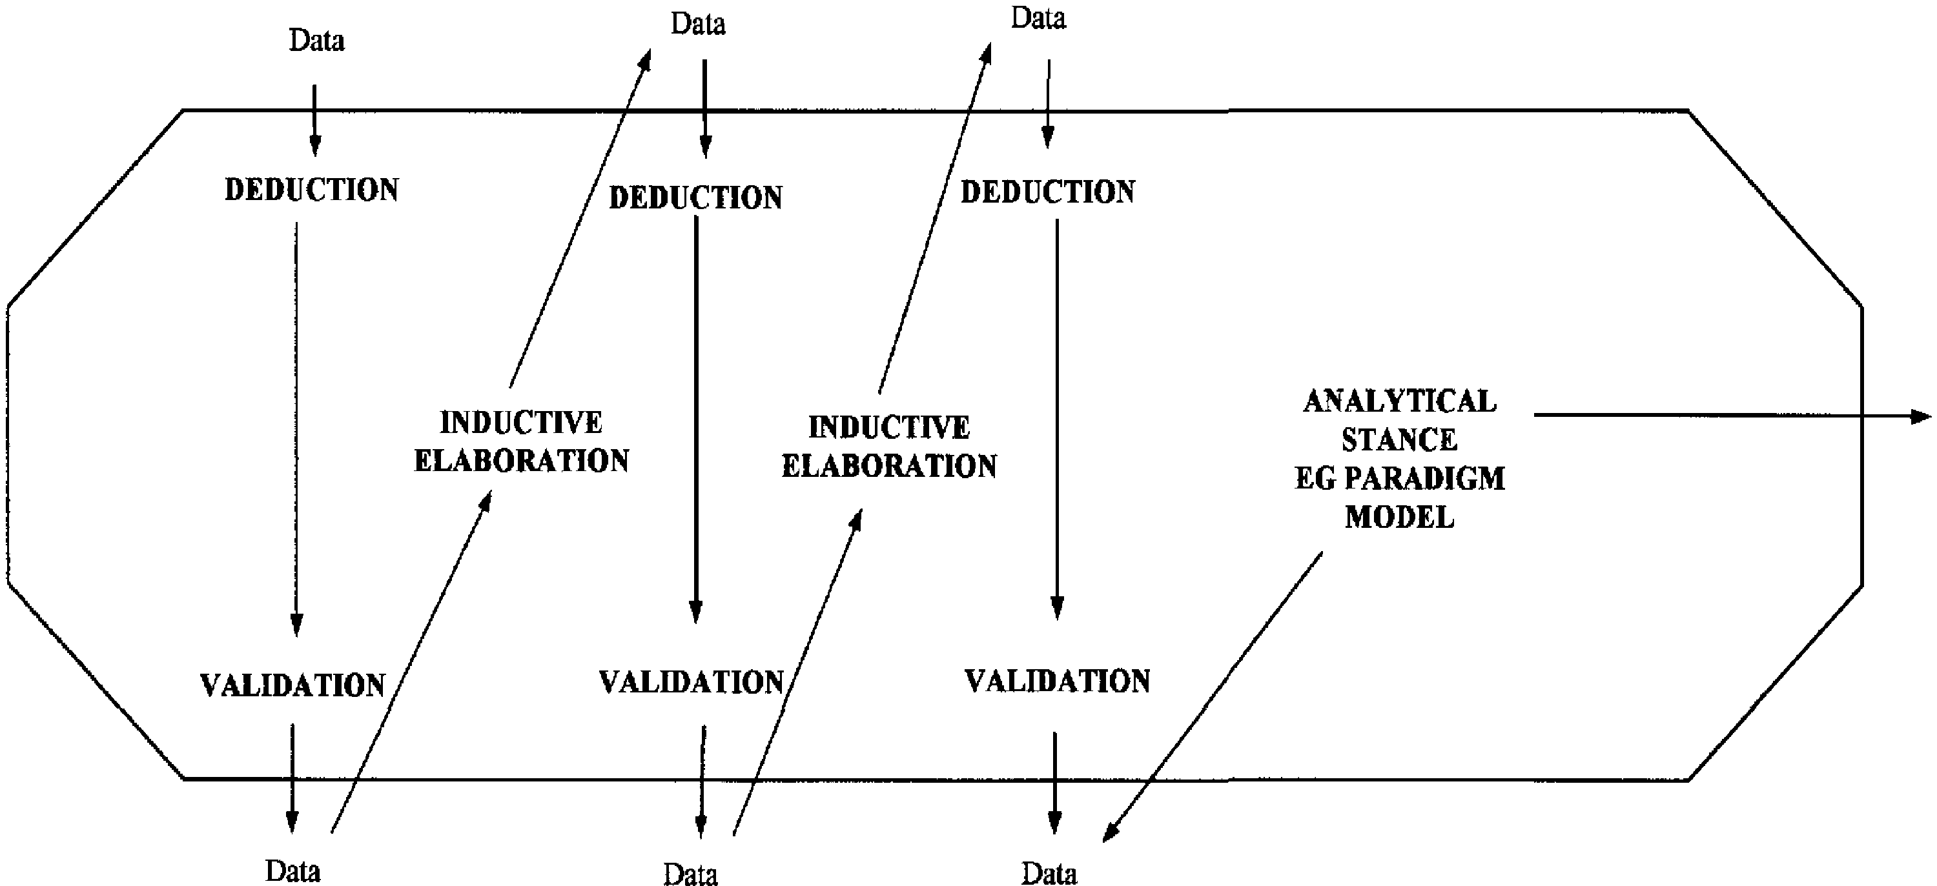
Strauss and Corbin (1998) induction, deduction, and validation in grounded theory analysis. (Heath and Cowley, 2004, p.145)

Slide 15
. Strauss (1987), Strauss and Corbin (1990) place of induction, deduction and veriﬁcation in grounded theory analysis. (Heath and Cowley, 2004, p.145)

Slide 16
Constructivist Grounded Theory - Kathy Charmaz
root of the constructivist theory is the belief that concepts are constructed, not discovered
constructivist, you begin with specific questions on a particular substantive area
Constructivist start with a literature review as the first step
Constructivist believe this is the next logical evolution of grounded theory from CGT to Straussian to Constructivist
An approach between positivism and postmodernism
Three levels of coding, open, focused, and theoretical

Slide 17
Manual vs. computerized data processing
“Users should be aware that many computer techniques are only marginal to the task of grounded theory. The process of theory emergence requires a different ability: to see the data as a whole, then to leave data behind, exploring the lines of this segment of that text. To code and retrieve text is to cut it up. The ‘grounded theory’ method leaves text almost untouched. The researcher’s contact with data is light, hovering above the text and rethinking its meanings, then rising from it to comparative, imaginative reflections. It is the difference between the touch of scissors and that of a butterfly.” Richards & Richards 1995

Slide 18
Evaluation of the empirical grounding of a grounded theory
Fit
Understandability
Generalizability
Control

Slide 19
Lessons Learned
Grounded Theory is only complex due to the mixed literature
Select the method that best represents your data and your method of research
Avoid method slurring
Most how to books are poorly written
GT research is no more time consuming than other methods
Keep referring back to the 'Fit, understandability, Generalizability and Control‘
Remember all is data

Slide 20
QUESTIONS ?
THANK YOU FOR LISTENING

