Slide 2
Acemoglu and Robinson’s studies of institutional and cultural mechanisms of successa

Slide 3
David Sloan Wilson
“Selfishness beats altruism within groups. Altruistic groups beat selfish groups. Everything else is commentary”.

Slide 4
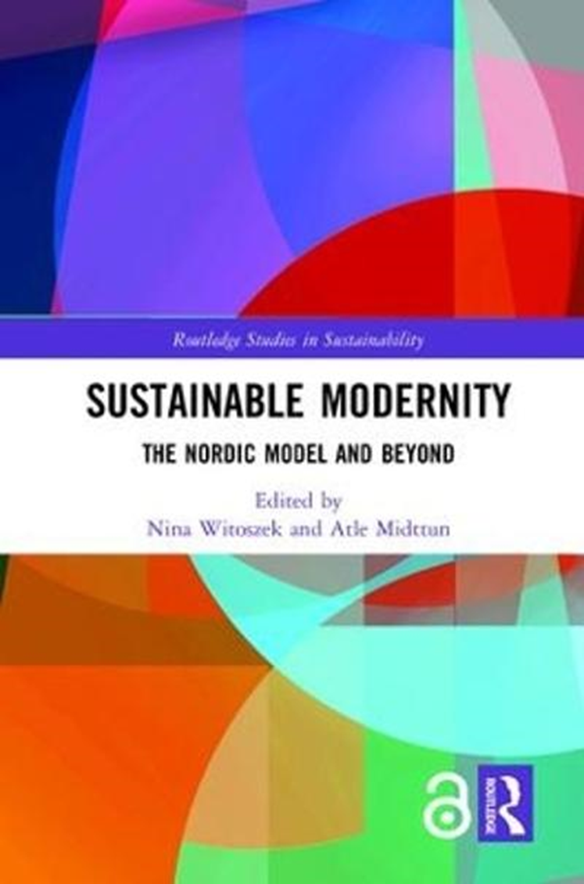

Slide 5
Atle Midttun and Nina Witoszek: “The Competitive Advantage of Collaboration: Throwing New Light on the Nordic Model”, New Political Economy 2019
https://www.researchgate.net/publication/335697946_The_Competitive_Advantage_of_Collaboration_-_Throwing_New_Light_on_The_Nordic_Model

Slide 7
Nina Witoszek, “The Difficult Beauty of Getting to Norway”
Cliodynamics, 5(1) 2014, pp. 132-136.
https://escholarship.org/content/qt6xw505xh/qt6xw505xh.pdf?t=pfo399.
Rzecz o trundosciach eksportu “norweskeigo modelu” do innych krajow.

Slide 8
