Slide 1






Slide 2

Resilience through digitalisation – can the public create the change?
This work was supported by the Polish National Agency for Academic Exchange, Strategic Partnerships, “Higher Education for Resilient Economy”, grant number (BNI/PST/2023/1/00016)

Slide 3
Why digitalization?
Digitalisation reduces trade costs and boosts export capacity: Higher digital and AI intensity directly increases exports; a 1% rise in AI intensity raises exports by 1.01%–1.30%, and digital‑intensity elasticity ranges from 0.85 to 2.03.
Strong ICT endowments promote intra‑EU trade: Countries with advanced ICT infrastructure trade more because digitalisation lowers transaction costs and simplifies cross‑border coordination.
Digital tools expand access to foreign markets by reducing information, communication, and language barriers while enabling real‑time supply‑chain management—speeding up delivery times and increasing trade in time‑sensitive goods.
Service exports grow fastest with digitalisation: Evidence from G20 countries shows digitalisation has a stronger positive effect on services trade than on goods trade, meaning digital economies become more resilient by diversifying into globally tradable services.
Paperless and digital trade processes strengthen resilience by lowering compliance time, reducing border delays, and maintaining trade flows during crises; UN data show paperless trade adoption ranges from 57% to 79% depending on region.

Slide 4
Why digitalization?
Digitalisation reduces trade costs and boosts export capacity: Higher digital and AI intensity directly increases exports; a 1% rise in AI intensity raises exports by 1.01%–1.30%, and digital‑intensity elasticity ranges from 0.85 to 2.03.
Strong ICT endowments promote intra‑EU trade: Countries with advanced ICT infrastructure trade more because digitalisation lowers transaction costs and simplifies cross‑border coordination.
Digital tools expand access to foreign markets by reducing information, communication, and language barriers while enabling real‑time supply‑chain management—speeding up delivery times and increasing trade in time‑sensitive goods.
Service exports grow fastest with digitalisation: Evidence from G20 countries shows digitalisation has a stronger positive effect on services trade than on goods trade, meaning digital economies become more resilient by diversifying into globally tradable services.
Paperless and digital trade processes strengthen resilience by lowering compliance time, reducing border delays, and maintaining trade flows during crises; UN data show paperless trade adoption ranges from 57% to 79% depending on region.

Slide 5
Why digitalization?
Digitalisation reduces trade costs and boosts export capacity: Higher digital and AI intensity directly increases exports; a 1% rise in AI intensity raises exports by 1.01%–1.30%, and digital‑intensity elasticity ranges from 0.85 to 2.03.
Strong ICT endowments promote intra‑EU trade: Countries with advanced ICT infrastructure trade more because digitalisation lowers transaction costs and simplifies cross‑border coordination.
Digital tools expand access to foreign markets by reducing information, communication, and language barriers while enabling real‑time supply‑chain management—speeding up delivery times and increasing trade in time‑sensitive goods.
Service exports grow fastest with digitalisation: Evidence from G20 countries shows digitalisation has a stronger positive effect on services trade than on goods trade, meaning digital economies become more resilient by diversifying into globally tradable services.
Paperless and digital trade processes strengthen resilience by lowering compliance time, reducing border delays, and maintaining trade flows during crises; UN data show paperless trade adoption ranges from 57% to 79% depending on region.

Slide 6
Why digitalization?
Digitalisation reduces trade costs and boosts export capacity: Higher digital and AI intensity directly increases exports; a 1% rise in AI intensity raises exports by 1.01%–1.30%, and digital‑intensity elasticity ranges from 0.85 to 2.03.
Strong ICT endowments promote intra‑EU trade: Countries with advanced ICT infrastructure trade more because digitalisation lowers transaction costs and simplifies cross‑border coordination.
Digital tools expand access to foreign markets by reducing information, communication, and language barriers while enabling real‑time supply‑chain management—speeding up delivery times and increasing trade in time‑sensitive goods.
Service exports grow fastest with digitalisation: Evidence from G20 countries shows digitalisation has a stronger positive effect on services trade than on goods trade, meaning digital economies become more resilient by diversifying into globally tradable services.
Paperless and digital trade processes strengthen resilience by lowering compliance time, reducing border delays, and maintaining trade flows during crises; UN data show paperless trade adoption ranges from 57% to 79% depending on region.

Slide 7
Why digitalization?
Digitalisation reduces trade costs and boosts export capacity: Higher digital and AI intensity directly increases exports; a 1% rise in AI intensity raises exports by 1.01%–1.30%, and digital‑intensity elasticity ranges from 0.85 to 2.03.
Strong ICT endowments promote intra‑EU trade: Countries with advanced ICT infrastructure trade more because digitalisation lowers transaction costs and simplifies cross‑border coordination.
Digital tools expand access to foreign markets by reducing information, communication, and language barriers while enabling real‑time supply‑chain management—speeding up delivery times and increasing trade in time‑sensitive goods.
Service exports grow fastest with digitalisation: Evidence from G20 countries shows digitalisation has a stronger positive effect on services trade than on goods trade, meaning digital economies become more resilient by diversifying into globally tradable services.
Paperless and digital trade processes strengthen resilience by lowering compliance time, reducing border delays, and maintaining trade flows during crises; UN data show paperless trade adoption ranges from 57% to 79% depending on region.

Slide 8
EU strategy for digital infrastructure
Institutional architecture
European Electronic Communications Code (EECC)
Legal and regulatory foundations for State aid
Multi‑level governance model

Slide 9
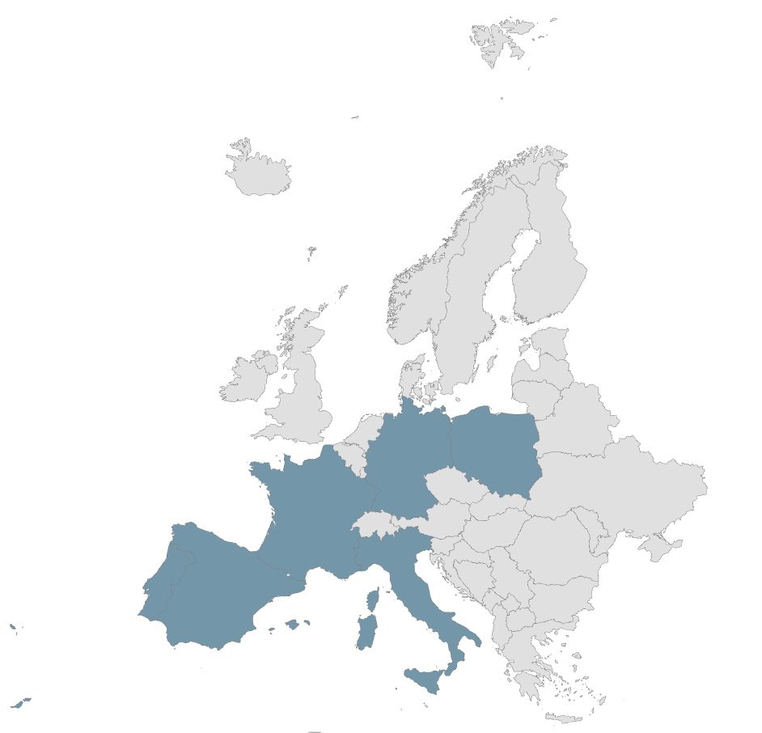
Sample and method
A panel dataset was constructed covering 2003-2023 with annual observations.
All data originate from the World Bank’s World Development Indicators, ensuring consistency and comparability across countries.
Method: regression

Slide 10
Key takeaways?
Broadband is the strongest predictor of export performance
Institutional and policy frameworks amplify the effect
Not all digital variables matter equally
A minimum bundle of digital readiness is necessary
Digital infrastructure benefits large firms and SMEs
Improved broadband reduces information and coordination costs

Slide 11
State sponsorship corrects market failures in high-cost digital infrastructure
Broadband is a strategic public good with large spillovers → justifying public investment
Publicly sponsored digital infrastructure becomes a national competitive capability
Sponsorship enables SMEs, broadening the export base
Institutional sponsorship (regulation, governance) matters as much as physical infrastructure
Sponsorship aligns with EU competition rules because it builds shared capabilities, not selective advantages

Slide 12
CREDITS
Content
ESIC University
Poznań University of Economics and Business
Voiceover
Generated with use of notegpt.io
Music
Technology Minimal
Images
The video has been prepared with use of Azure OpenAI ImageGen
This work was supported by the Polish National Agency for Academic Exchange, Strategic Partnerships, “Higher Education for Resilient Economy”, grant number (BNI/PST/2023/1/00016)

Slide 13

Resilience through digitalisation – can the public create the change?
based on the paper by Mroczek-Dąbrowska K., Kania, A., García-Monleón, F., Eizaguirre, M. and Gómez, A. titled” Digital Momentum and Trade Performance: Linking EU27 Digitalization Progress with Export and Import Flows”
This work was supported by the Polish National Agency for Academic Exchange, Strategic Partnerships, “Higher Education for Resilient Economy”, grant number (BNI/PST/2023/1/00016)

