Slide 1
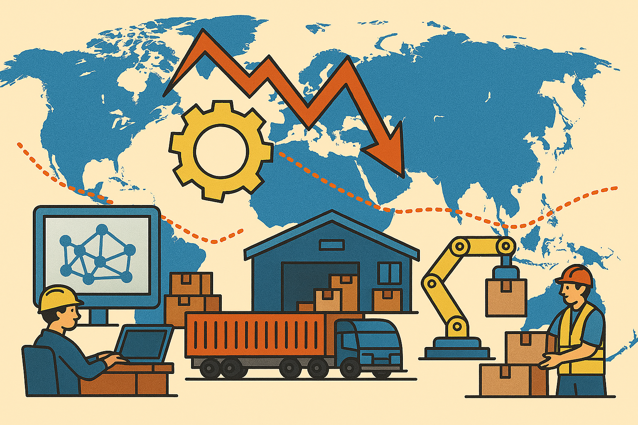





Slide 2
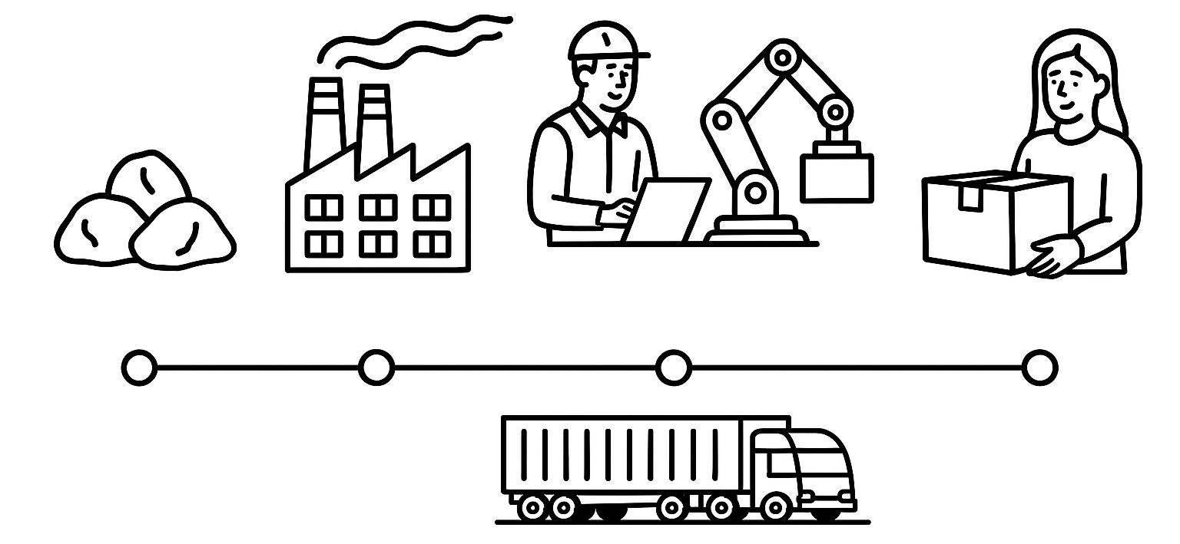
Supply Chain Resilience in a Geopolitical Era
This work was supported by the Polish National Agency for Academic Exchange, Strategic Partnerships, “Higher Education for Resilient Economy”, grant number (BNI/PST/2023/1/00016)

Slide 3
Geopolitical turbulence is now a structural driver of supply chain disruptions, rather than a temporary shock
Conflicts, sanctions, and trade tensions disrupt transport routes, raise costs, and expose systemic vulnerabilities
Strategic chokepoints (e.g., Suez/Red Sea) amplify global ripple effects—longer lead times, congestion, and shortages
Polish manufacturing is highly exposed due to deep integration in European and global production networks
Firms must adapt through resilience strategies such as diversification, network redesign, and capability development

Slide 4
Geopolitical turbulence is now a structural driver of supply chain disruptions, rather than a temporary shock
Conflicts, sanctions, and trade tensions disrupt transport routes, raise costs, and expose systemic vulnerabilities
Strategic chokepoints (e.g., Suez/Red Sea) amplify global ripple effects—longer lead times, congestion, and shortages
Polish manufacturing is highly exposed due to deep integration in European and global production networks
Firms must adapt through resilience strategies such as diversification, network redesign, and capability development

Slide 5
Geopolitical turbulence is now a structural driver of supply chain disruptions, rather than a temporary shock
Conflicts, sanctions, and trade tensions disrupt transport routes, raise costs, and expose systemic vulnerabilities
Strategic chokepoints (e.g., Suez/Red Sea) amplify global ripple effects—longer lead times, congestion, and shortages
Polish manufacturing is highly exposed due to deep integration in European and global production networks
Firms must adapt through resilience strategies such as diversification, network redesign, and capability development

Slide 6
Geopolitical turbulence is now a structural driver of supply chain disruptions, rather than a temporary shock
Conflicts, sanctions, and trade tensions disrupt transport routes, raise costs, and expose systemic vulnerabilities
Strategic chokepoints (e.g., Suez/Red Sea) amplify global ripple effects—longer lead times, congestion, and shortages
Polish manufacturing is highly exposed due to deep integration in European and global production networks
Firms must adapt through resilience strategies such as diversification, network redesign, and capability development

Slide 7
Geopolitical turbulence is now a structural driver of supply chain disruptions, rather than a temporary shock
Conflicts, sanctions, and trade tensions disrupt transport routes, raise costs, and expose systemic vulnerabilities
Strategic chokepoints (e.g., Suez/Red Sea) amplify global ripple effects—longer lead times, congestion, and shortages
Polish manufacturing is highly exposed due to deep integration in European and global production networks
Firms must adapt through resilience strategies such as diversification, network redesign, and capability development

Slide 8

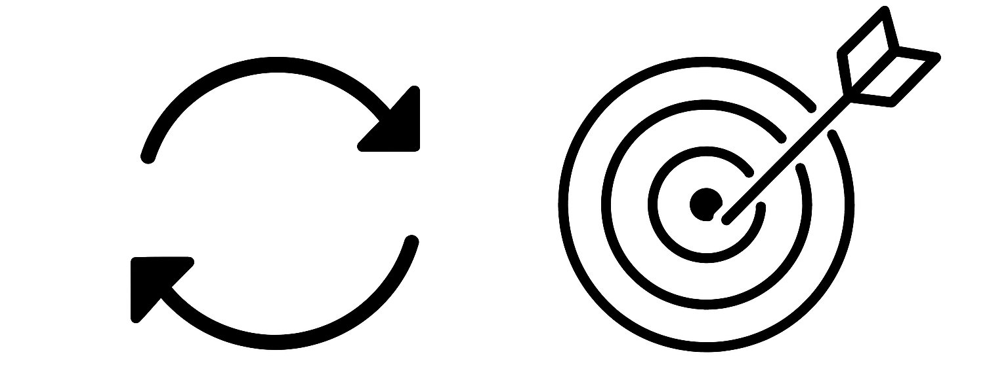
Resilience is built - not given
Proactive and reactive routines work together
Capabilities and supply chain design co-evolve

Slide 9
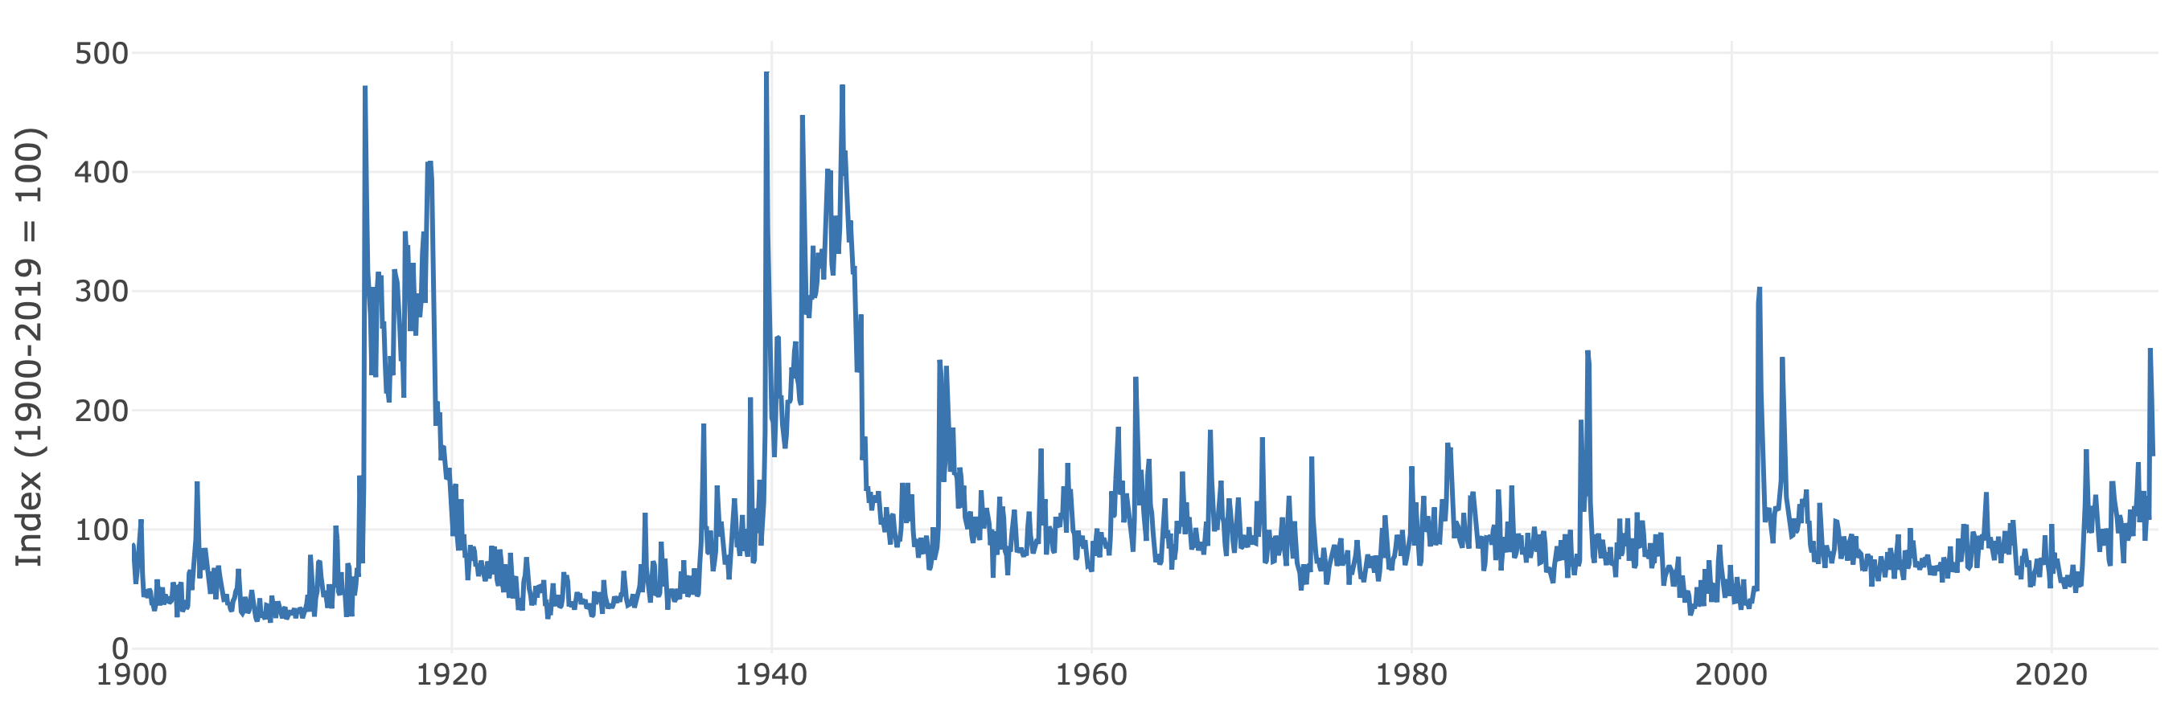
Geopolitical risk refers to the risk of instability and disruptions arising from political tensions between states, including threats, events, and escalations related to conflict, terrorism, and strained international relations; importantly, it encompasses both realized shocks and anticipatory uncertainty that can influence economic activity and supply chain dynamics (Caldara and Iacoviello, 2022)
Source: https://www.matteoiacoviello.com/gpr.htm

Slide 10
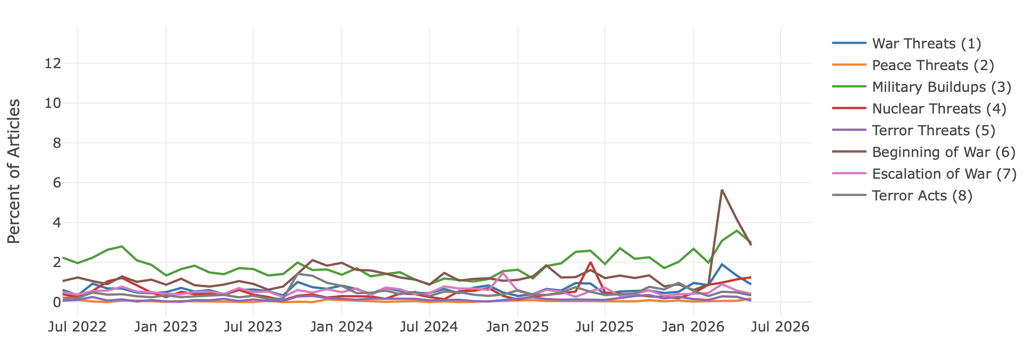
Geopolitical threat: An anticipated or potential source of tension or conflict, including rising political friction, military buildup, or diplomatic disputes, which generates uncertainty and influences expectations, investment decisions, and supply chain behavior even before any actual event occurs.
Geopolitical act: A realized event or action taken by states or non-state actors - such as military conflict, sanctions, trade restrictions, or terrorist attacks—that directly affects political and economic stability and can disrupt international relations and supply chains.
Source: https://www.matteoiacoviello.com/gpr.htm

Slide 11
Resource-based view
Dynamic capabilities view
Competitive advantage comes from valuable, rare, inimitable, and non-substitutable resources
Emphasizes resource ownership and accumulation
Best suited for stable or moderately changing environments
Focuses on the ability to reconfigure and renew resources over time
Emphasizes processes, routines, and adaptation
Enables firms to respond to turbulence and uncertainty
Limitations of RBV
Assumes relative stability
Limited ability to explain how firms adapt under rapid external shocks
Core processes
Sensing (identifying changes and risks)
Seizing (mobilizing resources)
Reconfiguring (transforming operations and structures)

Slide 12
What does that imply?
RBV explains advantage in stability
DCV explains adaptation in turbulence

Slide 13
Study design
Method: Partial Least Squares Structural Equation Modelling (PLS-SEM)
Sample: 341 manufacturing companies in Poland
Data collection: late October to mid-November 2025
Objective:
  How do geopolitical disruptions activate proactive and reactive dynamic capabilities within firms?
  RQ2: How do these capabilities influence (a) supply-chain design quality and (b) supply-chain resilience

Slide 14
Key takeaways
Geopolitical disruptions act as triggers, activating both proactive and reactive dynamic capabilities
Capabilities fully mediate outcomes - disruptions alone do not improve design or resilience
Proactive and reactive capabilities jointly shape supply chain design quality
Reactive capability is more critical for resilience, driving response speed and recovery
Adaptation depends on capability deployment, not the disruption itself
Resilience and redesign emerge from learning, reconfiguration, and response to shocks

Slide 15
Implications
Triggers
Structural fix
Geopolitical disruptions trigger capability development, confirming dynamic capabilities theory in high‑turbulence contexts
Managers must invest in both proactive and reactive capabilities, rather than relying on structural fixes alone
Adaptation
Resilience
Adaptation is indirect—performance and design improve only through capability activation, not disruptions themselves
Reactive capabilities are critical for resilience, emphasizing the importance of rapid response and recovery systems
Capability mix
Policy
Design and resilience require different capability mixes, highlighting the need for theoretical distinction between structural and performance outcomes
Policy should support firm capabilities, especially through information sharing, early warning systems, and crisis coordination

Slide 16
CREDITS
Content
University of Pforzheim
Poznań University of Economics and Business
Voiceover
Generated with use of notegpt.io
Music
Technology Minimal
Images
The video has been prepared with use of Azure OpenAI ImageGen
This work was supported by the Polish National Agency for Academic Exchange, Strategic Partnerships, “Higher Education for Resilient Economy”, grant number (BNI/PST/2023/1/00016)

Slide 17
Supply Chain Resilience in a Geopolitical Era
based on the paper by Kania A., Gaweł A., Berbig D. and Mroczek-Dąbrowska K., titled"Designing resilient supply chain networks under geopolitical tensions: evidence from Poland’s manufacturing sector”
This work was supported by the Polish National Agency for Academic Exchange, Strategic Partnerships, “Higher Education for Resilient Economy”, grant number (BNI/PST/2023/1/00016)

