Slide 1






Slide 2
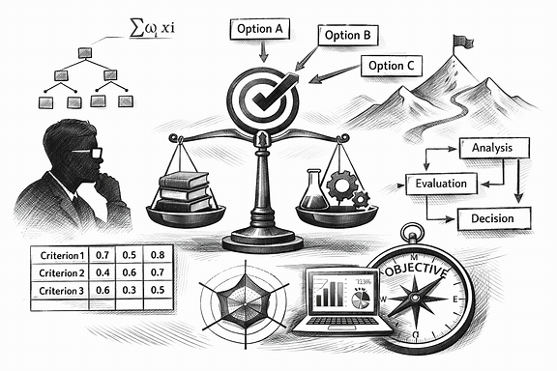
Research Decisions Unlocked — A Practical Introduction to Multi‑Criteria Decision Models
This work was supported by the Polish National Agency for Academic Exchange, Strategic Partnerships, “Higher Education for Resilient Economy”, grant number (BNI/PST/2023/1/00016)

Slide 3



Decision making – quantitative or qualitative approach?
Text
analysis
Simulation modelling
Expert judgment
Forecasting
Delphi method
Cost-Benefit analysis
Linear programming

Slide 4
Some key characteristics of research decision-making problems
Complex and multidimensional – involve multiple variables, stakeholders, objectives, and constraints that interact with one another.
High uncertainty – decisions are often made with incomplete information, limited evidence, or uncertain future outcomes.
Data-intensive – require collection, analysis, and interpretation of large amounts of qualitative and/or quantitative data.
Context-dependent – the best decision may vary depending on the specific organizational, social, economic, or environmental context.
Multiple criteria involved – decisions rarely depend on a single factor; cost, quality, risk, time, and stakeholder preferences must often be balanced.
Often involve conflicting objectives – optimizing one outcome may negatively affect another (e.g., minimizing cost vs. maximizing quality).
Interdisciplinary – may require knowledge from multiple fields such as statistics, economics, management, psychology, or engineering.

Slide 5
Is this a well-stated decision-making question?
Is geopolitics important for how companies behave?
No specific event but let’s leave the definition open for now
How do you define geopolitics? is there a specific act you have in mind or circumstances?
In what specific area? Trade? Investment?
What kind of companies? MNEs? SMEs?

Slide 6
Not exactly, so to make it more researchable we can revise it
Which geopolitical-related factors impact the perception of FDI-location attractiveness?
Geopolitical threats not acts
Caldara & Iacoviello (2022)
Greenfield investments of MNEs of CEE origin in emerging markets; manufacturing industries

Slide 7
So what methods can we use to combine approaches?
Conflicting objectives
High uncertainty
Inter-disciplinary
Multiple
citeria
Data
intensive
MCDM (Multiple Criteria Decision-Making) methods are a set of techniques used for decision-making in situations where there are multiple, often conflicting, criteria to consider. These methods help decision-makers evaluate and compare various alternatives based on different factors, which could include economic, social, environmental, or technical aspects. The goal is to identify the best or most optimal solution according to a set of predefined criteria.

Slide 8
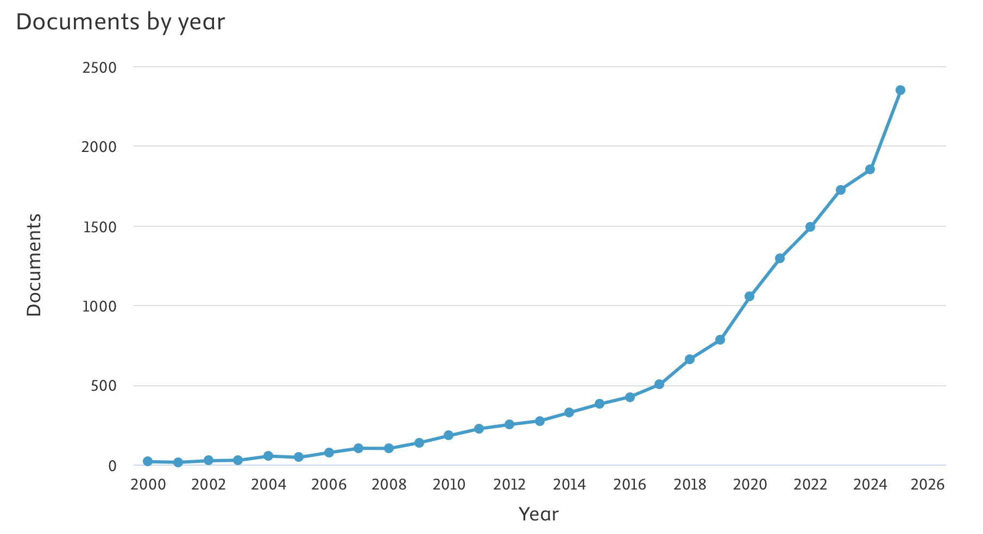
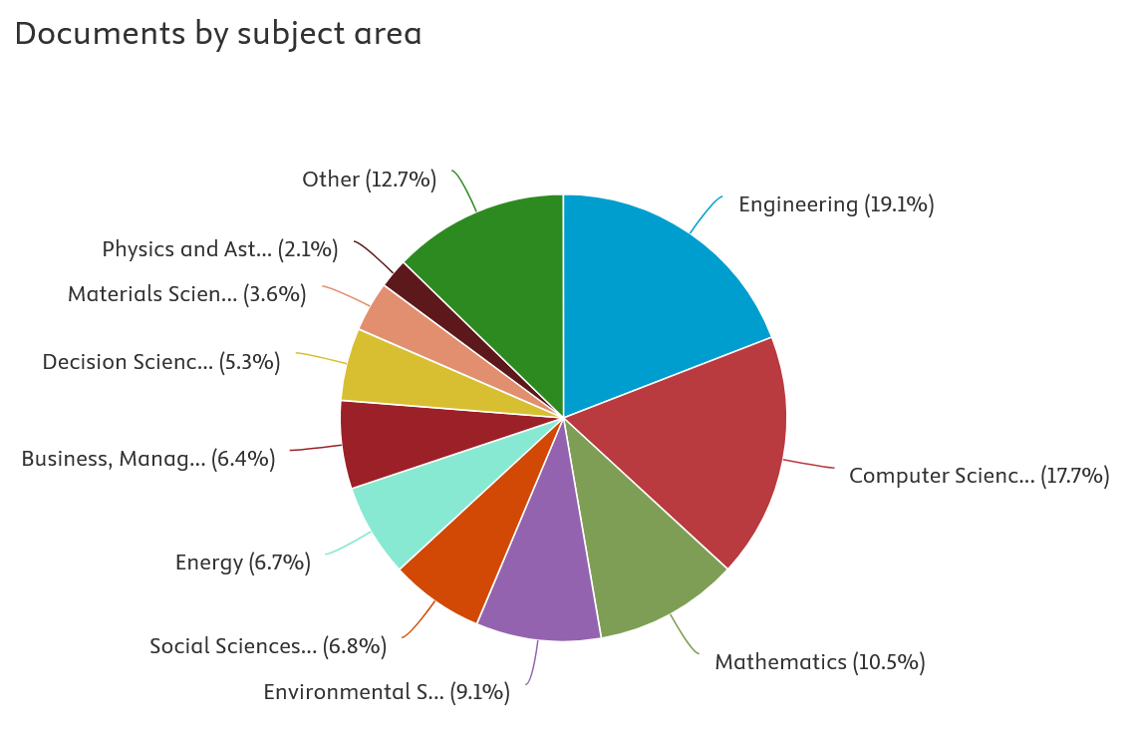
Is the MCDM method popular and publishable?
Source: Scopus database.

Slide 9
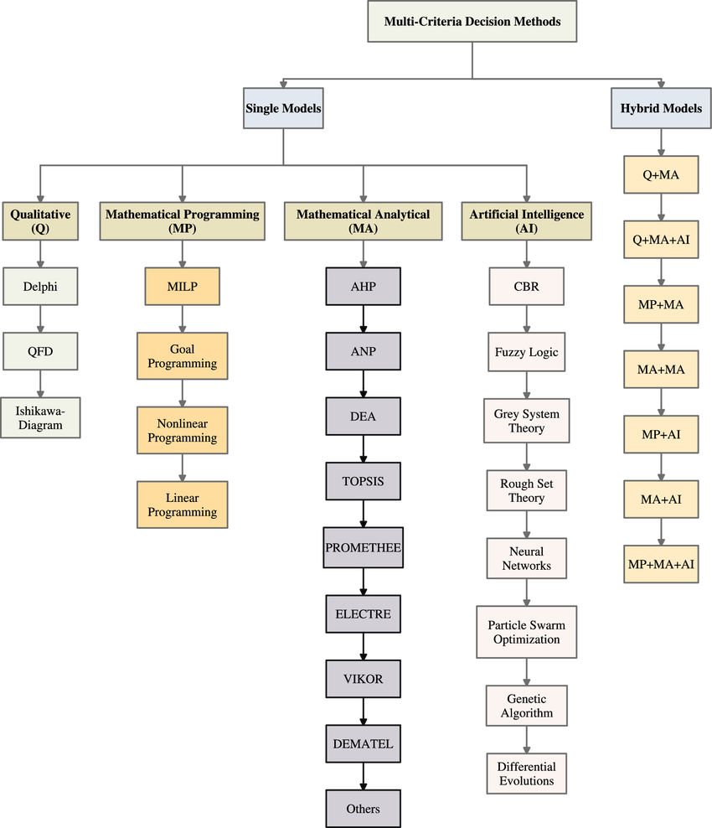
MCDM methods - it is a complicated story…
Source: Pandey, V., Komal & Dincer, H. A review on TOPSIS method and its extensions for different applications with recent development. Soft Comput 27, 18011–18039 (2023). https://doi.org/10.1007/s00500-023-09011-0
Classification shifts depending on the source

Slide 10
Which of the methods is specifically useful?
Conflicting objectives
High uncertainty
Inter-disciplinary
Multiple
citeria
Data
intensive
DEMATEL (Decision-Making Trial and Evaluation Laboratory) is considered an MCDM (Multiple Criteria Decision-Making) method, though it is often categorized more specifically as a technique for analyzing and modeling complex decision-making problems with interrelated criteria or factors.
DEMATEL is particularly useful for understanding the cause-and-effect relationships between different criteria or factors involved in a decision-making process. It helps to visually represent and quantify these relationships, often using a matrix to show how various elements influence each other. This method is valuable in situations where criteria are interconnected, and decision-makers need to understand the dependencies between them.

Slide 11
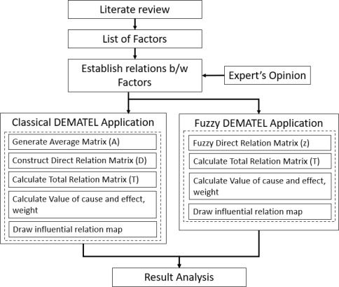
What is the analytical framework?
Part 1: Factors’ identification & data collection
Part 2: Analysis
Part 3: Modelling

Slide 12
Part 1 Factors’ identification & data collection
Questionnaire design
  Section 1: Rate the factors (Likert scale 1-5) to assess whether they are significantly impacting the perception of FDI-location attractiveness
  Section 2: Rate the interdependencies among the significant factors (Likert scale 1-5)
Data collection approach
  Typical questionnaire vs matrix
  One-stage vs multiple-stage approach
  Individualized vs focus groups

Slide 13



Part 2 Analysis
Software?
Strong visualization capabilities for representing relationships
Free and open-source
Specifically designed for decision-making methods
For ease of use: Super Decisions, Excel with add-ons, or ANP Software.
For advanced analysis and customization: MATLAB, R, or Python.
For visualization: Gephi, Vensim, or NetworkX.

Slide 14
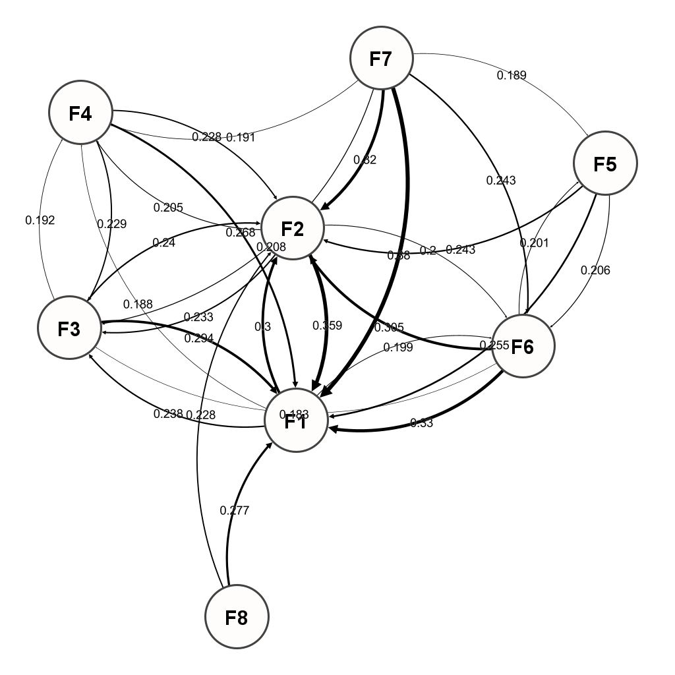
Part 3 Modelling
Cause-and-effect relationships between factors
Key driving factors (causes) that influence other factors in the system
Result factors (effects) that are mainly influenced by other factors
Strength of influence among factors
Direct and indirect interactions within the system
Feedback loops

Slide 15
CREDITS
Content
University of Economics and Business in Bratislava
Poznań University of Economics and Business
Voiceover
Generated with use of notegpt.io
Music
Technology Minimal
Images
The video has been prepared with use of Azure OpenAI ImageGen
This work was supported by the Polish National Agency for Academic Exchange, Strategic Partnerships, “Higher Education for Resilient Economy”, grant number (BNI/PST/2023/1/00016)

Slide 16
Research Decisions Unlocked — A Practical Introduction to Multi‑Criteria Decision Models
based on the paper by Mroczek-Dąbrowska K., Kania, A., Cherubin, D., Romanova, A. titled” FDI in the age of misinformation: A multi-criteria approach amid geopolitical uncertainty ”
This work was supported by the Polish National Agency for Academic Exchange, Strategic Partnerships, “Higher Education for Resilient Economy”, grant number (BNI/PST/2023/1/00016)

