Slide 1







Slide 2
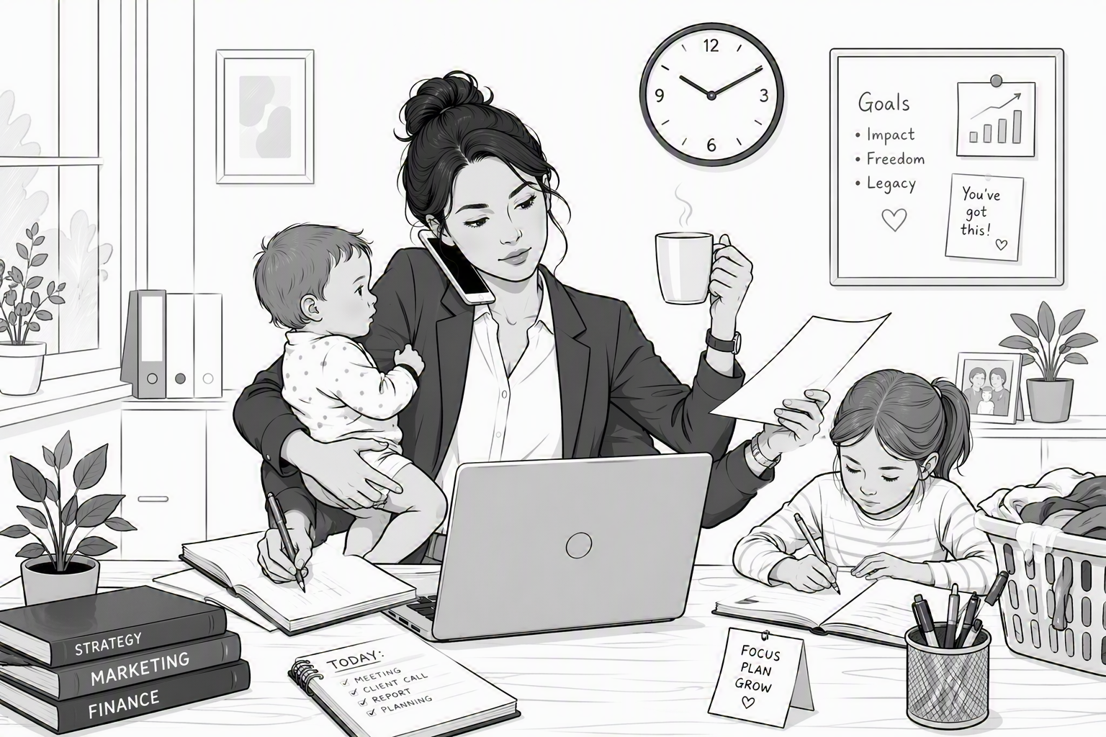
Understanding Women’s Entrepreneurial Resilience in Central Europe
This work was supported by the Polish National Agency for Academic Exchange, Strategic Partnerships, “Higher Education for Resilient Economy”, grant number (BNI/PST/2023/1/00016)

Slide 3
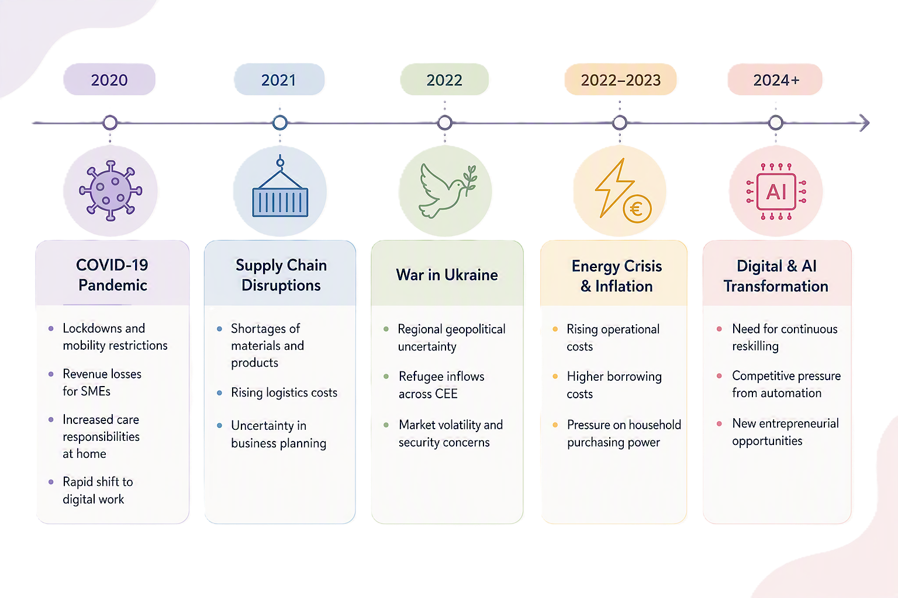
Policrisis in Central Eastern Europe

Slide 4
Resilience
PSYCHOLOGICAL RESLIENCE
STRATEGIC FLEXIBILITY
confidence, optimism, coping
Resilience
Adopting business models rapidly
RESOURCE ORCHESTRATION
CAPABILITY DEVELOPMENT
Assessing and deploying resources
learning, digital skills, innovation

Slide 5

Women entreprenurs often face:
Unequal access to finance
Work–family demands
Gender stereotypes
Digital inequalities
Structural barriers
Need for social support

Slide 6
What does RBV suggest?
POLYCRISIS
Economic impacts
Business and operational impacts
Social and gender-related impacts
Psychological impacts
Digital human and technological capabilities
Digital collaboration capabpilities
Dynamic capabilities
Sensing
Seizing
Reconfiguring
RESILIENCE

Slide 7

So we asked ourselves…
Are digital capabilities and collaboration really a driver of resilience for women entrepreneurs?
If yes, how?

Slide 8
Study design
Method: Structural Equation Modelling (CB-SEM)
Sample: 1,113 women entrepreneurs
Data collection: June-August 2025
Geographical scope: Germany, Poland, and Slovakia

Slide 9

Digitalisation?
Digital collaboration
is the most important digital capability, enabling stronger resilience through enhanced networking, knowledge sharing, and partnerships
Digital capabilities
strengthen resilience indirectly by supporting the development and deployment of dynamic capabilities.
Collaborative digital networks
help women entrepreneurs respond more effectively to uncertainty and disruption.

Slide 10

Women’s resilience?
Seizing capabilities
are the strongest driver of resilience, highlighting the importance of recognizing and acting on opportunities during uncertainty.
Sensing capabilities
support resilience by helping entrepreneurs identify changes, risks, and emerging opportunities in their environment.
Reconfiguring capabilities
howed a negative effect on resilience, suggesting that frequent organisational changes may strain small, resource-constrained women-owned businesses.

Slide 11
CREDITS
Content
University of Economics and Business in Bratislava
ISCTE Business Research Unit
Poznań University of Economics and Business
Voiceover
Generated with use of notegpt.io
Music
Technology Minimal
Images
The video has been prepared with use of Azure OpenAI ImageGen
This work was supported by the Polish National Agency for Academic Exchange, Strategic Partnerships, “Higher Education for Resilient Economy”, grant number (BNI/PST/2023/1/00016)

Slide 12
Understanding Women’s Entrepreneurial Resilience in Central Europe
based on the paper by Gaweł, A., Mroczek-Dąbrowska K., Blštáková, J., Pereira, R., Simba, A. titled” Integrating Capabilities and Feminine Role Identity in Women Entrepreneurs’ Resilience: A Central European Study”
This work was supported by the Polish National Agency for Academic Exchange, Strategic Partnerships, “Higher Education for Resilient Economy”, grant number (BNI/PST/2023/1/00016)

