Slide 1







Slide 2

Structural Equation Modeling (SEM)- Introduction
This work was supported by the Polish National Agency for Academic Exchange, Strategic Partnerships, “Higher Education for Resilient Economy”, grant number (BNI/PST/2023/1/00016)

Slide 3


Exploratory vs. confirmatory rsesearch
Exploratory Research
No well-established theory exists
A new or emerging problem
Aimed at gaining a deeper understanding of relationships and phenomena
Focus on research objectives and research questions
Confirmatory Research
Based on theories that we seek to test or validate
A known problem, but with the aim of extending existing knowledge
Focus on research objectives, research questions, and hypotheses

Slide 4
SEM as a confirmatory research method
1
2
3
4
5
6
7
Establish a theoretical foundation
Position the study within relevant theory or theories
Develop research hypotheses
Construct a conceptual model
Design and conduct data collection
Estimate and evaluate the model
Confirm or reject hypotheses

Slide 5

Planning Research Using Structural Equation Modeling (1)
Survey Questionnaire
Latent variables (constructs): theoretical concepts that cannot be observed or measured directly
Items (measurement items): observable indicators used to measure a latent construct
A set of items measuring the same construct is often referred to as a scale (or measurement scale)

Slide 6
Planning Research Using Structural Equation Modeling (2)
Construct: Technological innovation capabilities (TIC)
  Items - TIC (example):
TIC1: The firm produces key and related products/services of high quality.
TIC2: The firm can improve its products/services based on new technologies.
TIC3: The firm can effectively control products/services’ production time to meet the urgent demand.
TIC4: The firm can master and adopt key advanced technologies in the industry.
TIC5: The firm has innovations to enhance production processes and internal management systems.
TIC6: The firm’s technological capability allows the effective production of products/services.
TIC7: The firm’s existing technology and process are environmentally friendly and cost-saving.

Slide 7
Planning Research Using Structural Equation Modeling (3)
Sources of Measurement Scales
  Custom-developed scales
  Scales previously validated in the literature
Custom-Developed Scales
  Acceptable, but this should be explicitly stated in the publication
  Risk that the newly developed scale may be inadequate or invalid
  Developing new scales typically requires separate studies involving: expert review, pilot testing, further expert evaluation, final validation
  Adapting existing scales to a specific national context (e.g., language and culture) also requires separate validation studies
Validated Scales
  The dominant approach in research design
  Identify publications in which the scale has been used
  Review citations of publications that have applied the scale

Slide 8
Planning Research Using Structural Equation Modeling (4)
After collecting the data, it is necessary to demonstrate:
(1) Internal consistency of the construct:
  All items (statements) adequately reflect the construct.
  Use of Confirmatory Factor Analysis (CFA).
  Factor loading for each item (preferably above 0.7 and statistically significant).
  Measures of construct reliability and validity (e.g., Average Variance Extracted (AVE), Composite Reliability (CR), Cronbach’s α, McDonald’s ω).
(2) Distinctiveness of each construct (discriminant validity):
  No excessively high correlations between constructs.

Slide 9
Planning Research Using Structural Equation Modeling (5)
Conclusion: Great care must be taken when designing the survey questionnaire.
  Data collection: Can be conducted independently or through platforms and research agencies.
Number of respondents:
  Formally: Number of items × 5 (minimum) or × 10.
  Practically: Minimum 200 respondents.
Respondent groups:
  Consumer studies (including employee surveys): A sample of 200 would be too small for a prestigious journal (some author guidelines specify a minimum of 1,000 respondents or data from two countries); a more realistic sample size is around 500.
  It is difficult to collect such large samples among managers and highly qualified specialists.
  SEM model quality measures are sensitive to the number of respondents.
  CB-SEM (Covariance-Based SEM) dominates in consumer research, whereas PLS-SEM (Partial Least Squares SEM) is more commonly used with smaller respondent groups, e.g., 200–300 participants.

Slide 10
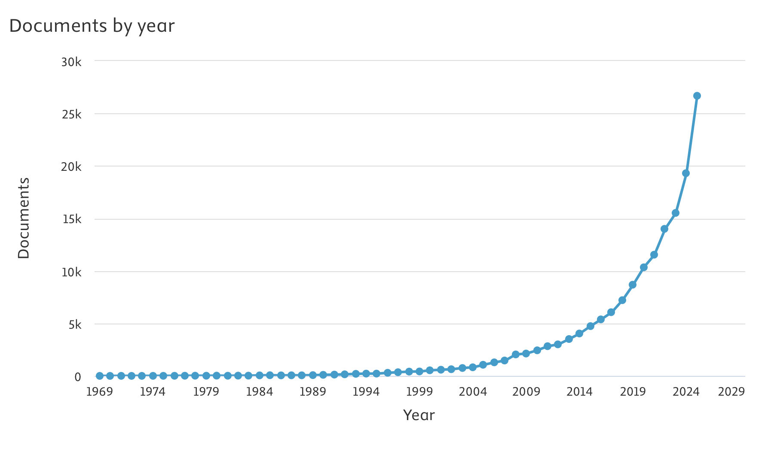
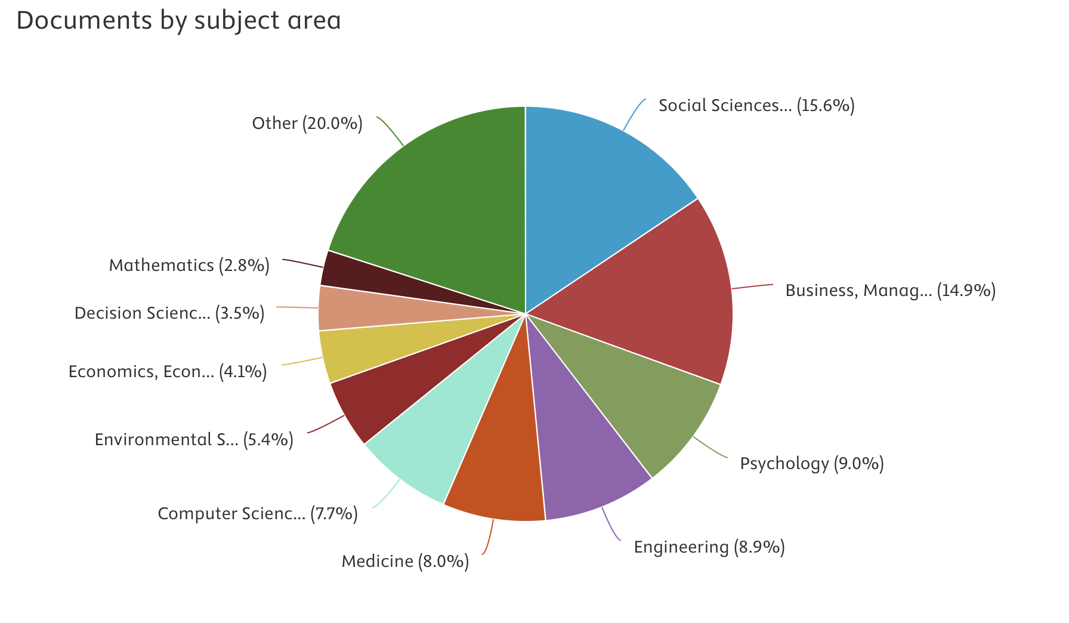
How popular is SEM?
Source: Scopus database

Slide 11
CREDITS
Content
University of Economics and Business in Bratislava
ISCTE Business Research Unit
Poznań University of Economics and Business
Voiceover
Generated with use of notegpt.io
Music
Technology Minimal
Images
The video has been prepared with use of Azure OpenAI ImageGen
This work was supported by the Polish National Agency for Academic Exchange, Strategic Partnerships, “Higher Education for Resilient Economy”, grant number (BNI/PST/2023/1/00016)

Slide 12
Structural Equation Modeling (SEM)- Introduction
The methodological guidance provided in this presentation is based on insights and best practices documented across multiple scholarly publications developed within the NAWA HERE project using SEM-based analyses.
This work was supported by the Polish National Agency for Academic Exchange, Strategic Partnerships, “Higher Education for Resilient Economy”, grant number (BNI/PST/2023/1/00016)

